Slide 1
Raising the Bar
Scott Bailey
Global Research Services Director
Squire Patton Boggs LLP
SCALL Institute Keynote
March 2016

Slide 2
Where are we?
Total revenues up 4.5%
Slight decrease in number of lawyers
Which led to an impressive growth in revenue per lawyer: 5.1%
Profits increased almost 7%
Now in a pattern of slow, steady growth
“A Smooth Ride:
After a long, bumpy journey, the Global 100 reaches its cruising altitude.”
Source:: AMLAW Global 100, American Lawyer, 10/1/15

Slide 3
Altman Weil Law Firms in Transition
The survey found signs of optimism in spring 2015:
75% expect gross revenue to be up over 2014 numbers
33% say demand for legal services has returned to pre-recession levels
41% expect demand to return in the next few years
“many [firms] are failing to make systemic and strategic changes . . . the largest firms [are] doing more to adapt than their colleagues at smaller shops.”
Law360
Source: Altman Weil, 2015 Law Firms in Transition 2015

Slide 4
Altman Weil Law Firms in Transition
Key Findings:
Profit increases are clearly linked to strategic changes
Leaders with high level of decision making authority = better economic performance
Overcapacity of equity & non-equity partners is a drag on profitability
Non-traditional competitors are taking business from law firms
“Two-thirds of law firm leaders think the pace of change in the profession is still increasing. Another 30% believe it will remain at its current pace (which is not inconsiderable)”
Source: Altman Weil, 2015 Law Firms in Transition 2015

Slide 5
Citi Private Bank’s Law Firm Group
“full-year revenue and profit performance will likely lag 2014's results, but will still be in positive territory”
Predicts 2015 revenue and profit growth to fall short of 2014 because:
Demand growth slowed in the third quarter
Revenue growth through the first nine months lagged the same period of 2014
Expenses are growing
Source: Citi Report: Law Firms Face Slowdown in Demand, The American Lawyer, November 9, 2015

Slide 6
2015 Chief Legal Officer Survey
40% plan to decrease their spend on outside counsel by:
Doing the work in house (76%)
Using vendors (13%)
Use contract lawyers (9%)
20% plan to increase their spend
What they want from outside counsel:
Greater cost reduction
Improved budget forecasting
Non-hourly based pricing
Take a more innovative approach to how their work is done
Stop over lawyering (more appropriately match the level of risk)
Make a greater effort to understand their business
“Chief Legal Officers want to work more collaboratively with law firms to rethink how their work is priced, managed and staffed.”
Sources: Chief Legal Officer Survey , Altman Weil, Inc. 2015

Slide 7
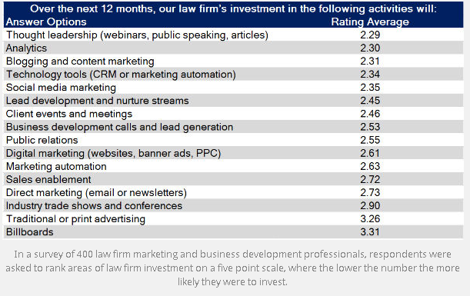
Legal Industry 2015
How Law Firms Plan to Fuel Growth in the Next 12 Months
Source: How Law Firms Plan to Fuel Growth in the Next 12 Months, Business of Law Blog

Slide 8
American Lawyer Law Librarian Survey 2015
Loungebrary: growing trend
Centralizing the library in back offices continues
69% are planning to eliminate the majority of the print collection in the next five years
Training lawyers and staff in how best to use new digital services is a bigger part of librarians’ jobs
73% are recovering less than the previous year
Librarians are doing more strategic and analytical research, tech support and competitive intelligence for business development than in the past
Source: The Bookless Library; Recent redesigns speak volumes about the changing role of firm libraries and the librarians who oversee them, The American Lawyer, 7/1/15.

Slide 9
Competitive Intelligence
Find | Analyze | Develop Conclusions
CI is often confused with Business Development
CI is the part that focuses on identifying your competition and determining how best to position the firm to compete with them
Intelligence is about cutting through the vast amounts of clutter or data to produce insights and analytics to drive business
.
Sources: CI & Law Firms: An Integral Part of the Legal Business, Mark Gediman, 3 Geeks and a Law Blog; CI & Law Firms: The Analysis Conundrum, Mark Gediman, 3 Geeks and a Law Blog; C Is For…., Zena Applebaum, 3 Geeks and a Law Blog

Slide 10
Teamwork on the Legal Frontline
Competitive Intelligence is where the library and marketing converge
80% percent monitor litigation involving their clients or as a tool to find new clients.
86% rely on tools such as Google, LexisNexis® Publisher, Westlaw Watch, Ozmosys and Manzama to monitor current information and developments on key competitors, clients and industries and spot trends.
The report recommends law librarians “be more proactive as internal business development consultants, not only to investigate and acquire tools and resources, but to support and better understand the practice group’s needs.”
Source: Teamwork on the Legal Frontline: The Strategic New Roles of Marketing and the Library in Big Law, Robyn Rebollo and Deborah Schwarz, LAC Group

Slide 11
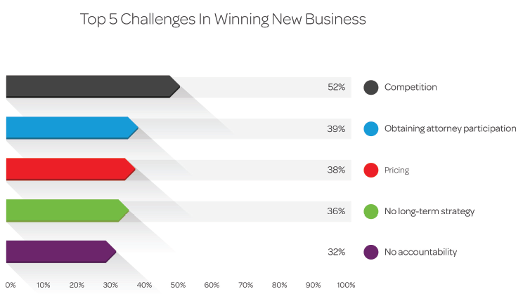
Law Firms in Business Development Transition Survey
Firms are transitioning from a marketing-driven new business paradigm to one that embraces business development
A relationship oriented approach is the key element that differentiates business development from marketing
Identifying the return on investment of various marketing and BD initiatives is a common challenge for marketing and business development leaders
Source: Law Firms in Business Development Transition Survey, LexisNexis

Slide 12
“The greatest danger in times of turbulence is not the turbulence; it is to act with yesterday’s logic”.
Peter Drucker

Slide 13
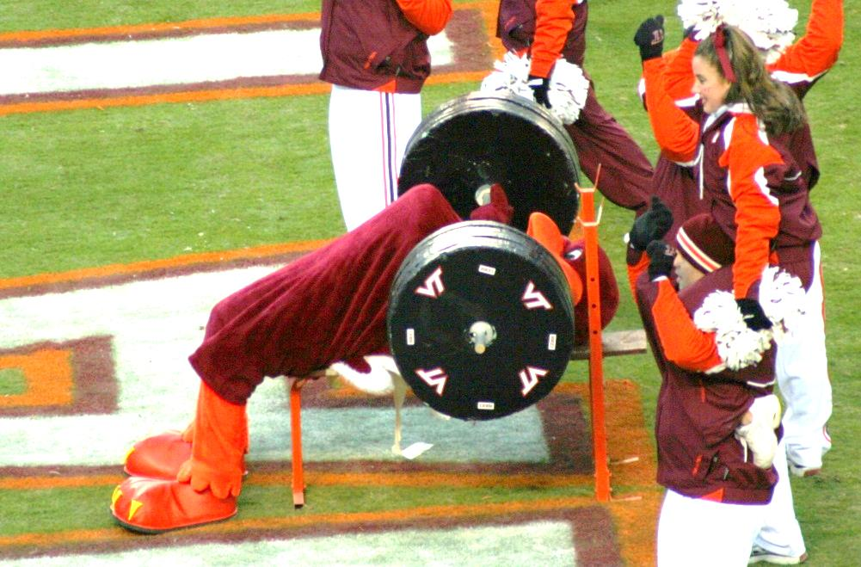
DEMONSTRATING VALUE

Slide 14
RAISING THE BAR WORKSHEET
CHALLENGES
SOLUTIONS
________________
________________
________________
________________
________________
________________

Slide 15
RAISING THE BAR: WORKING IT OUT
CHALLENGES
SOLUTIONS
________________
________________
________________
________________
________________
________________

Slide 16
 | Scott D. Bailey Global Director of Research Services Squire Patton Boggs (US) LLP 2550 M St NW Washington, DC 20037 T +1 202 626 6708 O +1 202 626 6600 F +1 202 626 6780 Scott.Bailey@squirepb.com | squirepattonboggs.com

