Slide 1
Turning Information Into Insight
2016 SCALL Institute
Temecula, CA – March 5, 2016
PRESENTED BY
Paul Moorman Scott Bailey Patrick Sullivan
Foreign & International Global Director of CA Region Research Librarian
Law Librarian Research Services Jones Day
USC Gould School of Law Squire Patton Boggs LLP psullivan@jonesday.com pmoorman@law.usc.edu scott.bailey@squirepb.com

Slide 2
Really?

Slide 3
It’s really very simple…

Slide 4
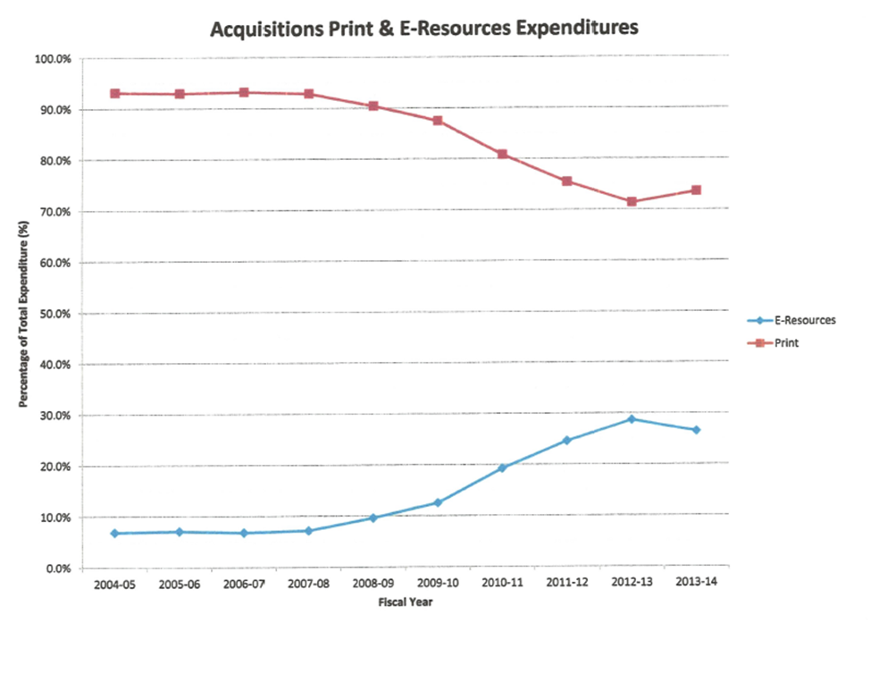

Slide 5
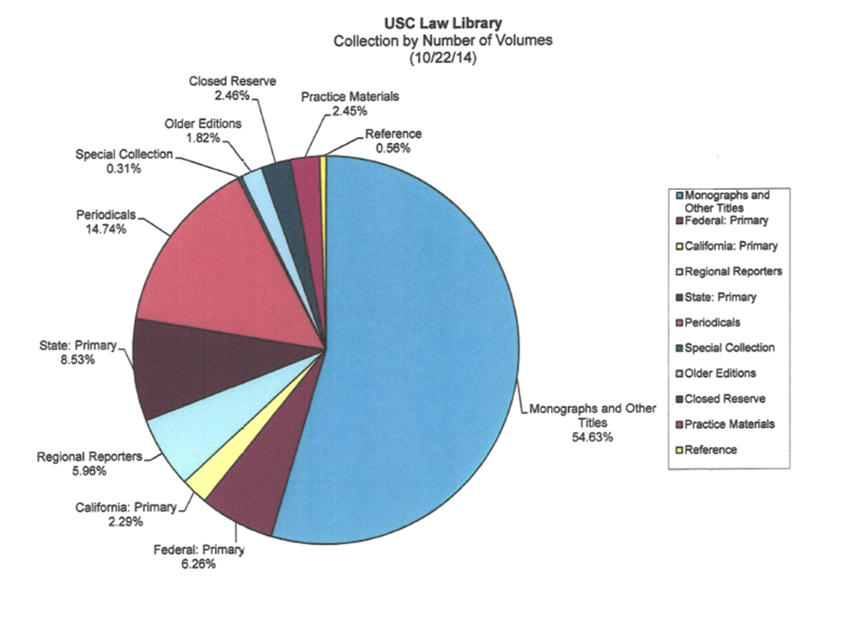

Slide 6
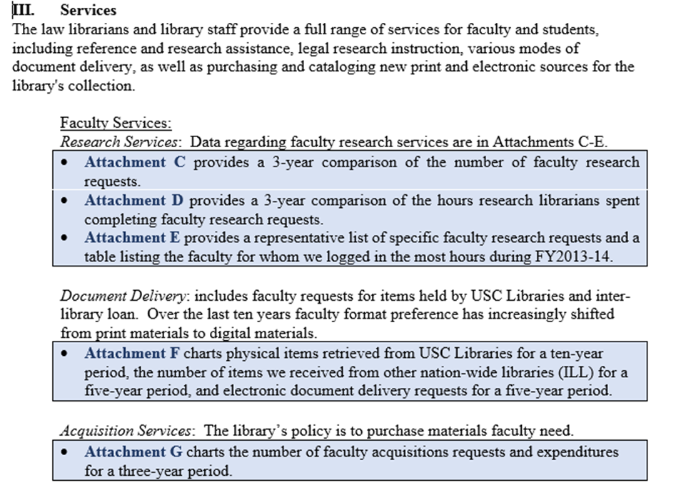

Slide 7
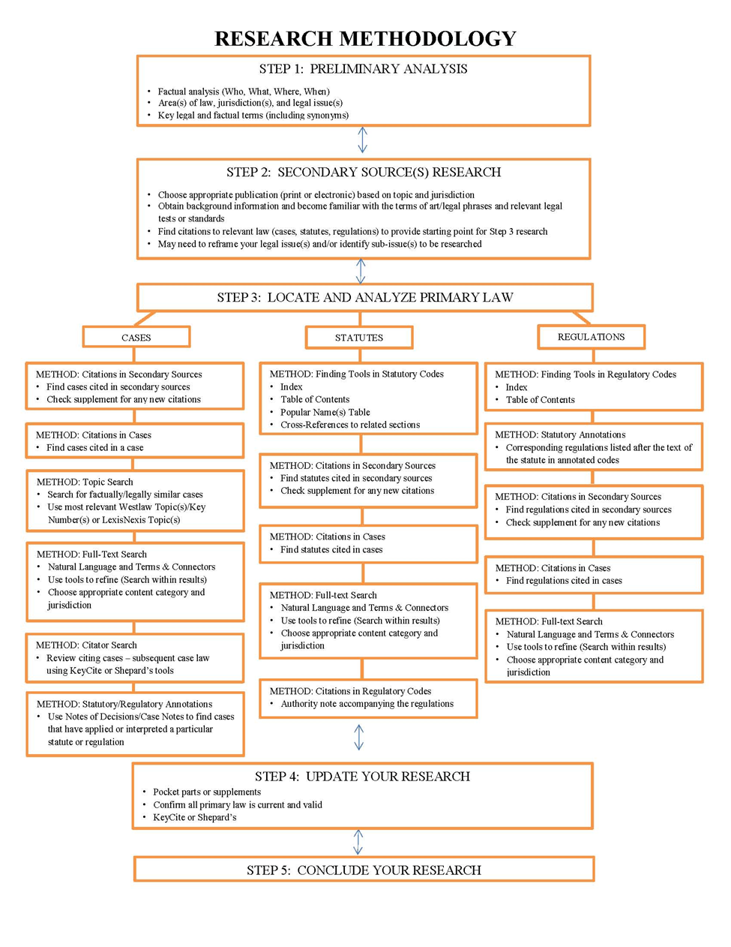

Slide 8
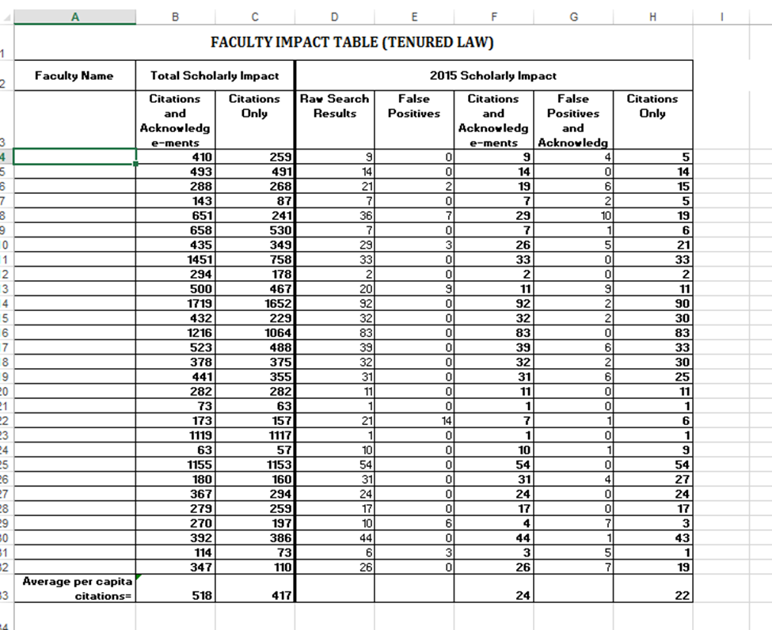

Slide 9
How to say the unthinkable: No, as a matter of fact, you are NOT getting that document.
That data just does not exist.
The data will take 3 days to acquire.
The data IS available right now!***
That data would require me to be a hacker.
That data is unpublished. No, really.
That data is not available with our tools.

Slide 10
Thank you for attending.
Paul Moorman Scott Bailey Patrick Sullivan
Foreign & International Global Director of CA Region Research Law Librarian Research Services Librarian
USC Gould School of Law Squire Patton Boggs LLP Jones Day
pmoorman@law.usc.edu scott.bailey@squirepb.com psullivan@jonesday.com

