Slide 1
The 44th Annual SCALL Spring Institute: March 4-5, 2016
Upping Your Swagger!

Slide 2
RAP
Reason: Look at the obstacles that keep us from achieving our potential.
Approach: a heart-to-heart conversation about those things that hold us back, with some real world scenarios to use as examples to brainstorm on solutions.
Ultimately, I hope our collective wisdom inspires all of us to go beyond our comfort zone, to not settle for the status quo, and to get our “swagger” up!

Slide 3
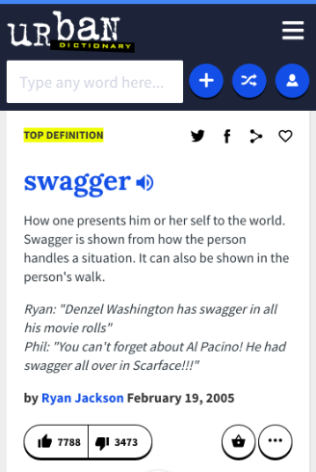

Slide 4
Setting The Stage: Where We’ve Been
Background
Speaking in generalities, exceptions exist.
Not an accusation, but an observation.
While the examples I frequently use are in law firms, they apply to law schools and government libraries as well.
Biggest heartbreak in the Law Librarian Profession:
The Knowledge Management Debacle

Slide 5
Knowledge Management:
Knowledge management is the process of capturing, distributing, and effectively using knowledge within an organization.

Slide 6
Setting The Stage: Where We’ve Been
Why did it happen?
We were busy!
We didn’t bill ourselves as Technology Experts.
We are “Librarians.”

Slide 7
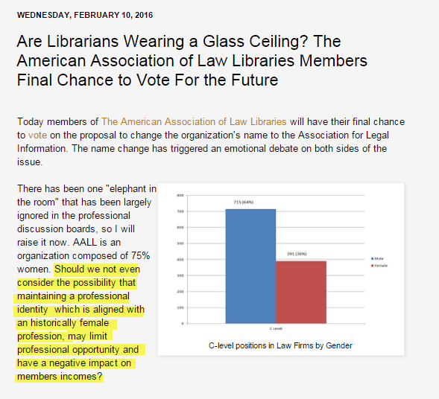

Slide 8
Setting The Stage: Where We’ve Been
Why did it happen?
We were busy!
We didn’t bill ourselves as Technology Experts.
We are “Librarians.”
Sexism.

Slide 9
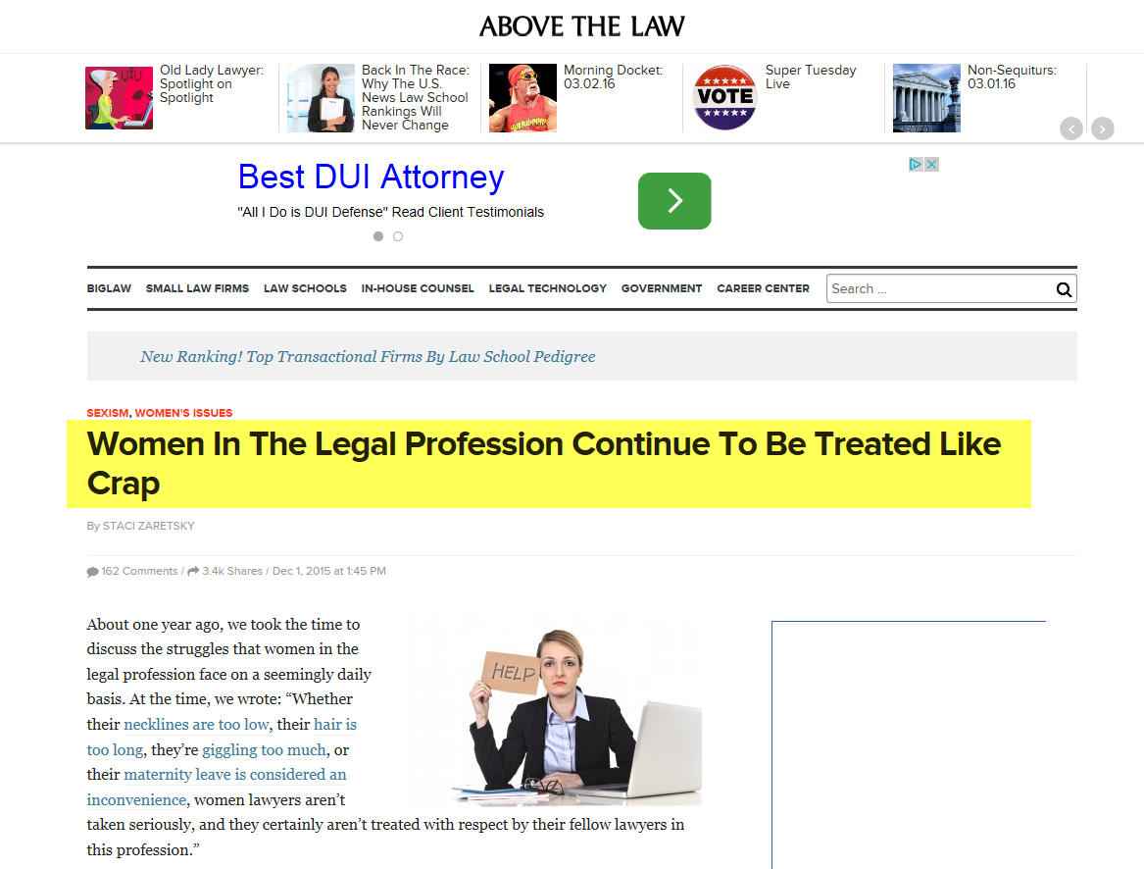

Slide 10
Setting The Stage: Where We’ve Been
Why did it happen?
We were busy!
We didn’t bill ourselves as Technology Experts.
We are “Librarians.”
Sexism.
We didn’t go after it.
We lacked the confidence.

Slide 11
The Future: Where We Need To Be
We need to busy with the right things.
We need to embrace technology.
We need to be “information” professionals.
We need to make allies with others.
We need to own it.
We need confidence. Swagger!

Slide 13
Myths About Bragging:
#1: A job well done speaks for itself.
#2: Bragging is something you do during performance reviews
#3: Humility gets you noticed.
#4: I don’t have to brag; people will do it for me.
#5: Bragging is immodest.

Slide 14
The New Reality:
We need to brag about the right stuff. In the right way.
We need to convey excitement about our work and our accomplishments.
We need to learn how to accept compliments.
We need to learn how to replace “face time.’
We need to believe in ourselves or no one else will.

Slide 15
Scenario One
You’ve just been informed that management is considering bringing in a Library Consultant to give the firm advice on the library you manage.

Slide 16
Scenario Two
You know you should get in front of the attorneys at the monthly Practice Area lunch, but they’ve never asked you, and you’re uncomfortable pushing in. And you’re intimidated, anyway, to speak in front of that many attorneys at once.

Slide 17
Scenario Three
You’ve been repeatedly passed over for a promotion, or denied a raise. You feel stuck, unappreciated, undervalued.

Slide 18
Up your swagger
You got this!

