Slide 1





Santa Barbara, CA

Slide 2
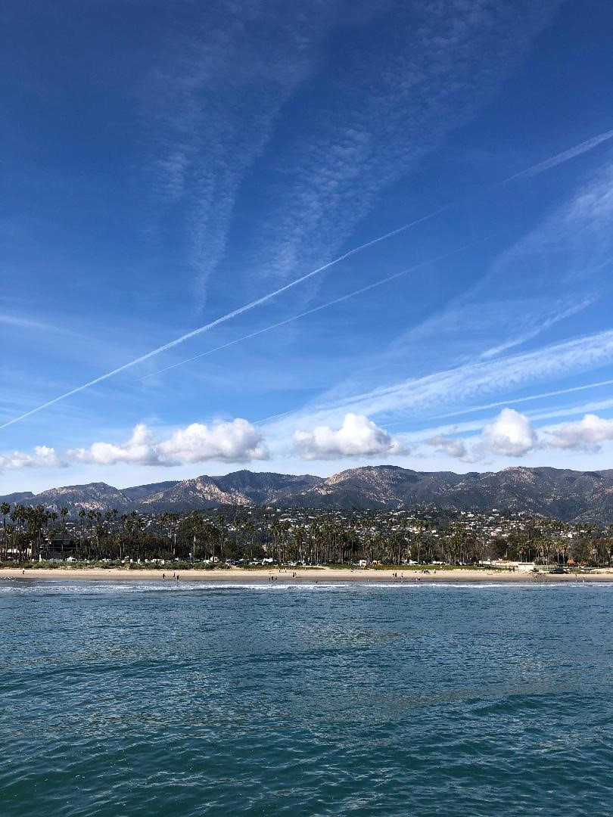

Saturday, February 24th
10:45 am
Practical Prompt Engineering
Cara Henley Johnson
Knowledge & Research Manager
O'Melveny & Myers

Slide 3

Agenda
GAI Prompt Tips
AI Use Cases with sample prompts
Takeaways

Slide 4


Slide 5

GAI Prompt Tips
Craft for the AI tool you are using – content, open/closed, public/private
Include the user and audience
Define the output – list, letter, table, chart, memo
Be specific, but not too specific
Revise and edit your prompts
Use AI to improve its own results

Slide 6
ABCs of Prompt Verbs
Analyze/Address/Advise
Build/Brainstorm
Create/Compose/Classify
Draft/Describe/Design
Evaluate/Explain
Find/Formulate/Frame
Generate/Group/Guess
Highlight/Hypothesize
Interpret/Illustrate
Justify/Join
Keep/Know
List/Limit/Learn
Make/Modify
Narrate/Name/Narrow
Outline/Organize
Predict/Provide
Question/Quantify
Recommend/Rewrite
Summarize/Support
Translate/Trace/Tell
Use/Uncover
Validate/Visualize/Vary
Write/Watch
eXtract/eXplore
Yield
Zero In/Zoom

Slide 7


Westlaw Specific Prompt Tips
Use clear, concise language that focuses on one issue and relevant facts and jurisdiction
Do NOT write as a prompts or command
Do NOT use names of clients or parties (ex: use "tech industry CEO" instead of "Steve Jobs")
Be content aware: primary law, treatises not yet usable, Practical Law in separate platform

Slide 8
Lexis Specific Prompt Tips

Slide 9
Use Case
Based on the recent pickleball craze, HOA installs a pickleball court in an open area of its communal property. The pickleball games are very loud and disturb a homeowner whose bedroom is 60 feet from the new court. Homeowner asks your firm for help.

Slide 10
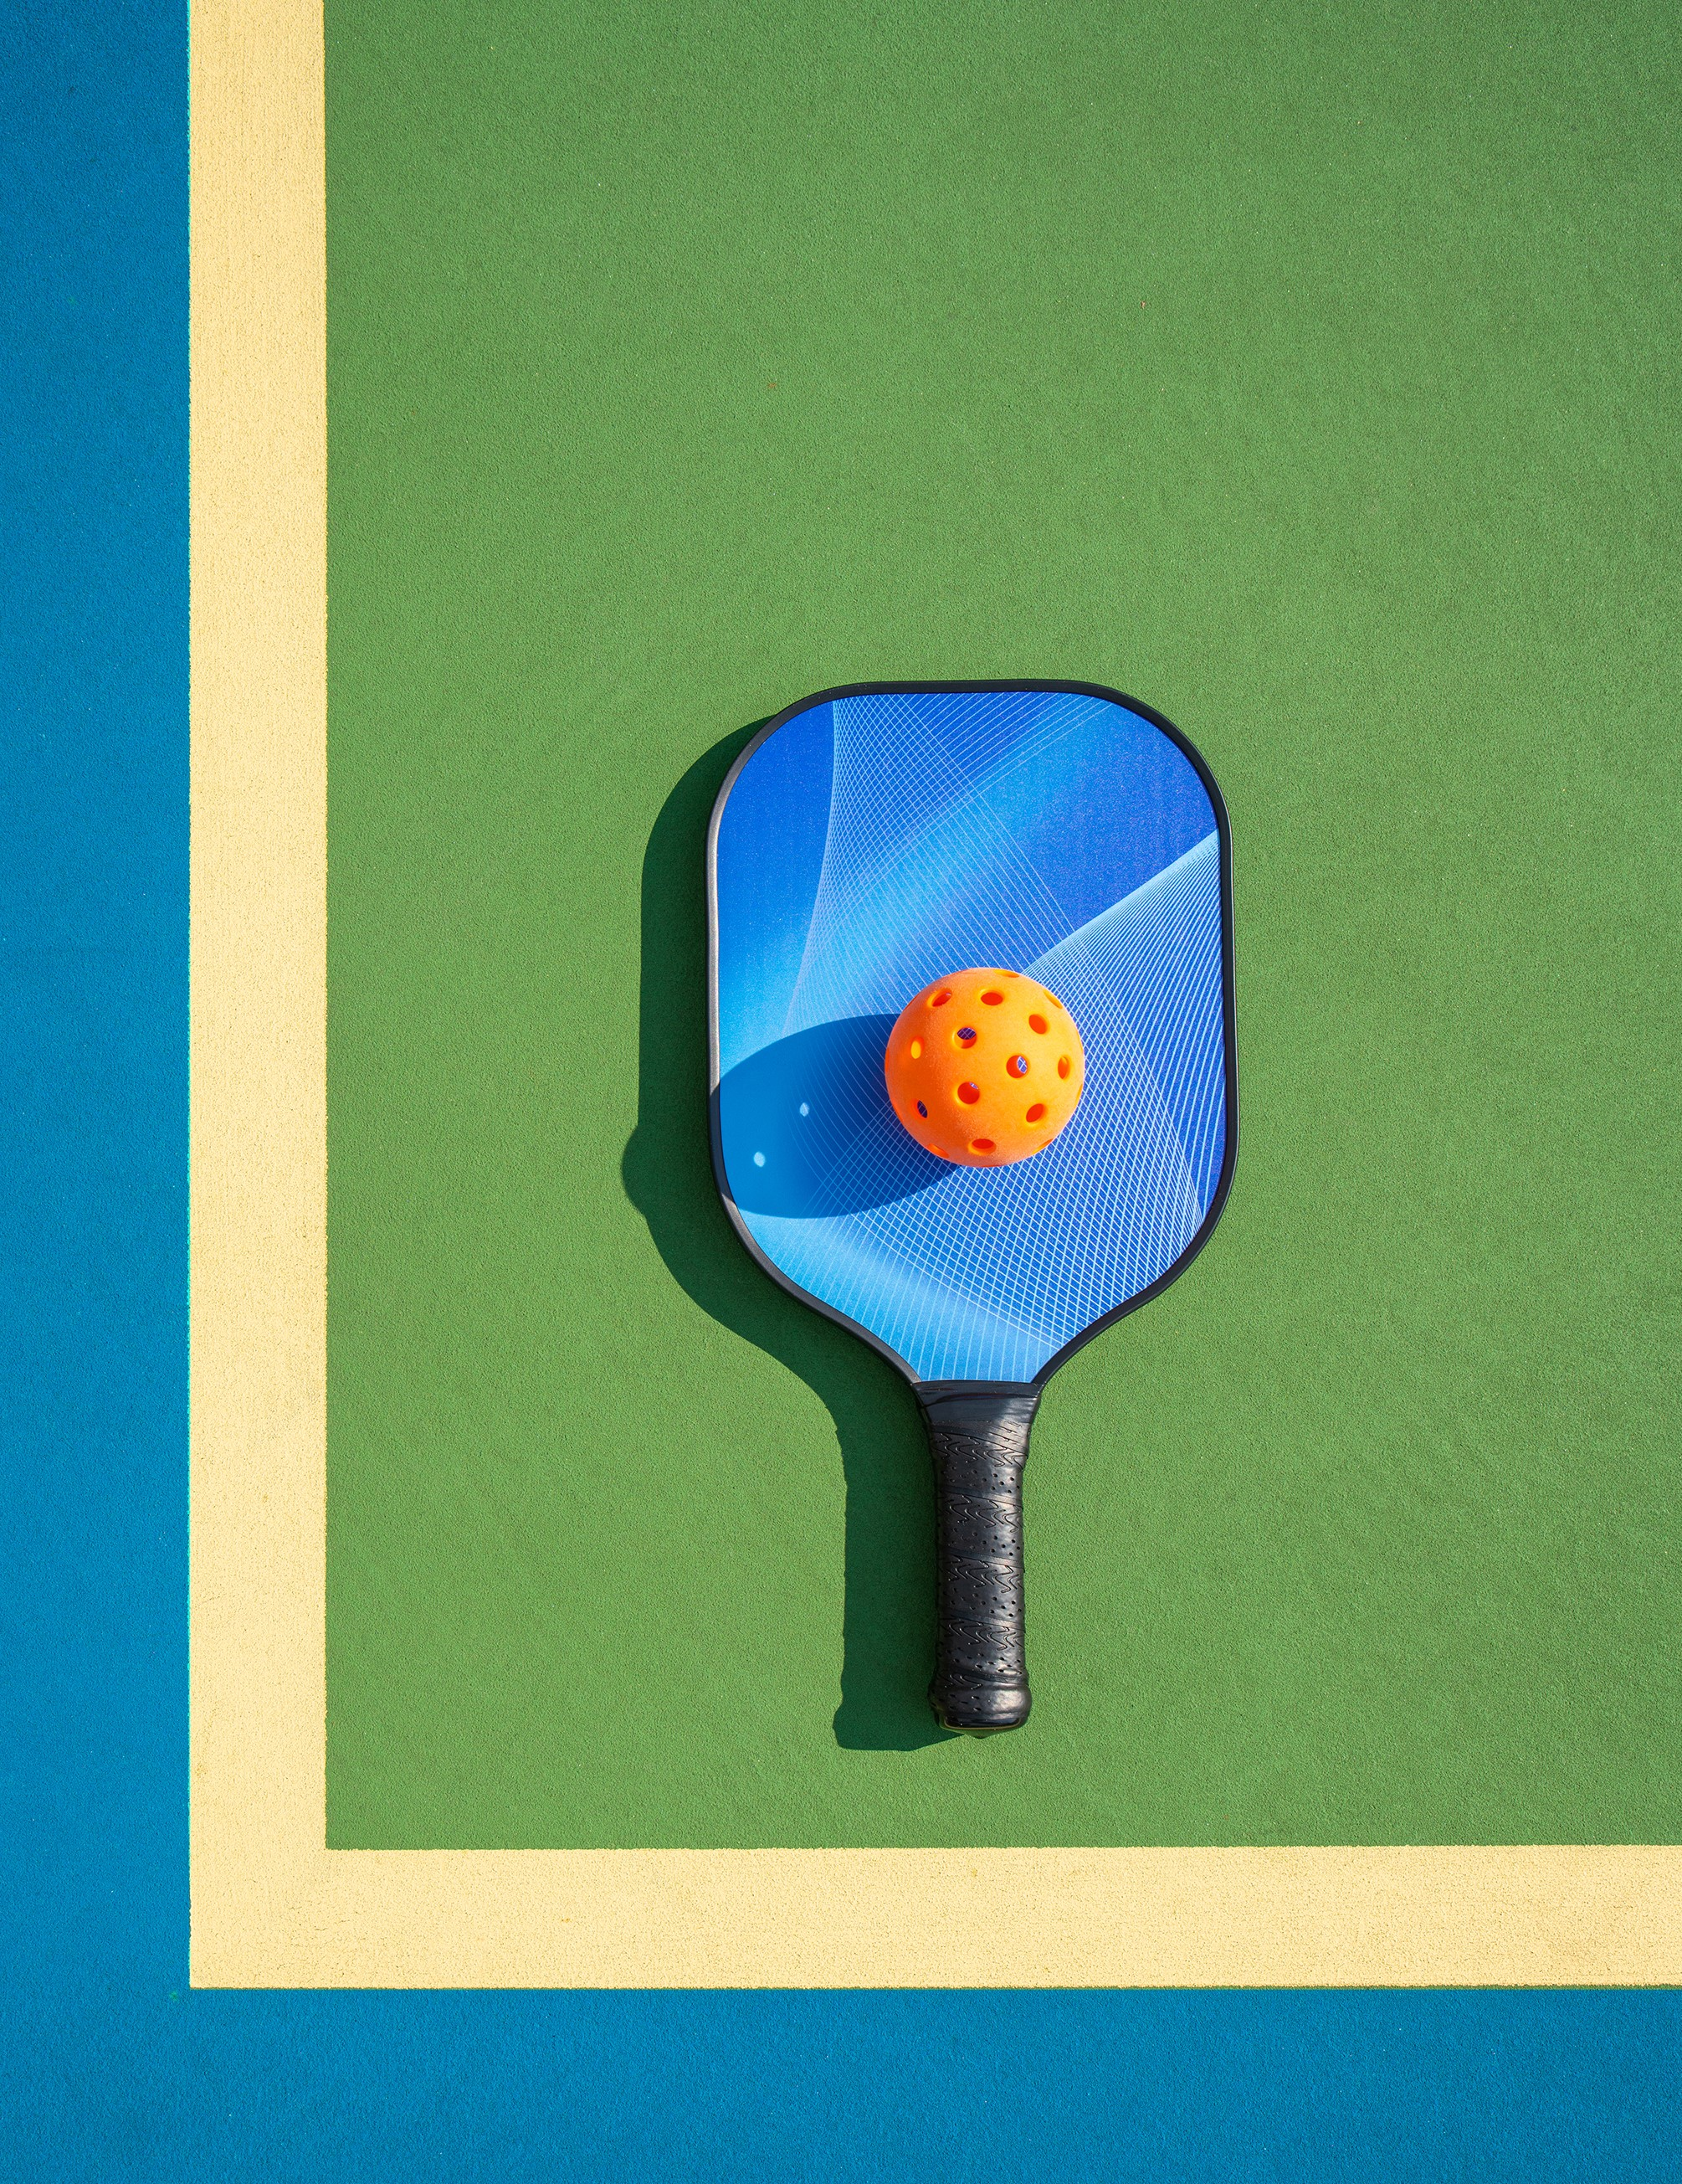
Prompt One: Background Knowledge
How often do homeowners sue HOAs over pickleball?

Slide 11
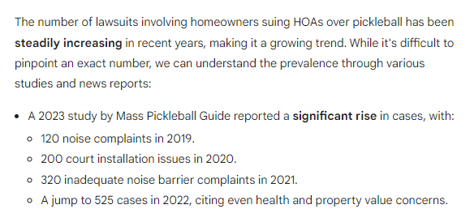
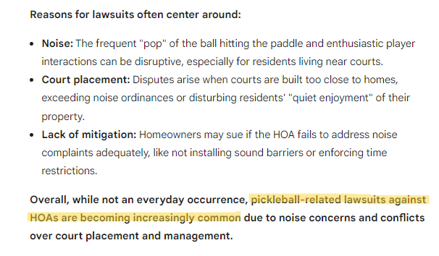
Prompt One: Background Knowledge

Slide 12
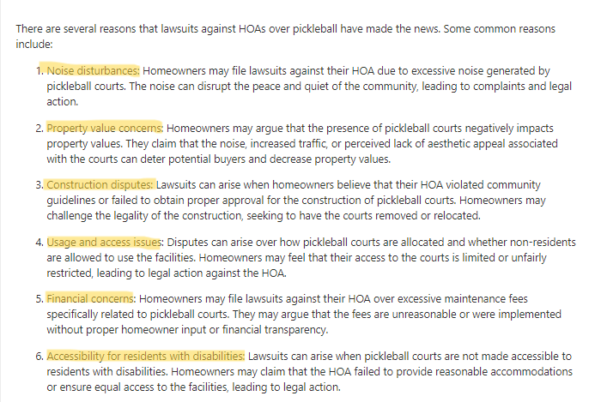
Prompt One:
Use AI
to Improve
Results

Slide 13
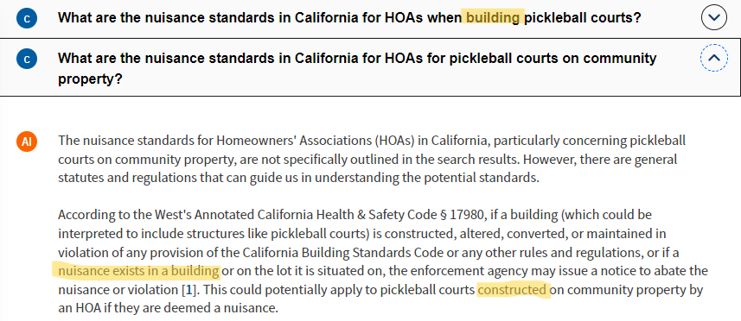
Prompt Two: Legal Research

Slide 14
Prompt Two: Revise and Edit
What standard do homeowners need to meet to sue HOAs over noise disturbances from pickleball courts?

Slide 15
Prompt Two: Revise and Edit
To sue Homeowners Associations (HOAs) over noise disturbances from pickleball courts, homeowners or the HOA, as representatives of the homeowners, must satisfy several criteria.
First, the HOA or individual homeowners must have standing to sue, meaning they are directly affected by the issue at hand [2]. The HOA has standing to sue as a representative of the individual homeowners when the question is one of a common or general interest of many persons [2]. This standing extends to situations where it is impracticable to bring all affected parties before the court [1, 3]. The HOA also has the right to institute, defend, settle, or intervene in legal proceedings without having to join the members . . .
Third, the HOA or homeowners must be able to establish the violation of a right or a breach of duty by the party being sued. If the noise from the pickleball courts causes a nuisance that violates the homeowners' right to quiet enjoyment of their property, this could form the basis of a lawsuit . . .
Lastly, it's important to note that decisions of condominium association boards are subject to deferential review, which means courts will usually uphold their decisions unless they are unreasonable.

Slide 16
Prompt Three:
Legal
Drafting
Draft a complaint in LA Superior Court for homeowner suing their HOA for nuisance from excessive noise caused by new pickleball court on communal property near their bedroom. Include causes of action for property value decreasing and financial concerns over maintenance fees increasing due to pickleball court.

Slide 17
Prompt Three: Legal Drafting
COMPLAINT FOR NUISANCE, DECLARATORY RELIEF, AND INJUNCTIVE RELIEF
Plaintiff [name of homeowner], an individual, alleges as follows:
Plaintiff is the owner of a single-family residence located at [address of property] within the [name of common interest development] (the "Development").
Defendant [name of homeowners association] (the "HOA") is a nonprofit mutual benefit corporation organized and existing under the laws of the State of California, and is the governing body of the Development . . .
FIRST CAUSE OF ACTION (NUISANCE) . . .
PRAYER FOR RELIEF
WHEREFORE, Plaintiff prays for judgment against the HOA as follows:
For compensatory damages in an amount to be proven at trial . . .

Slide 18

Prompt Three: Change Audience to Client
Write letter from attorney to client informing them nuisance complaint against HOA was filed and asking to meet.

Slide 19
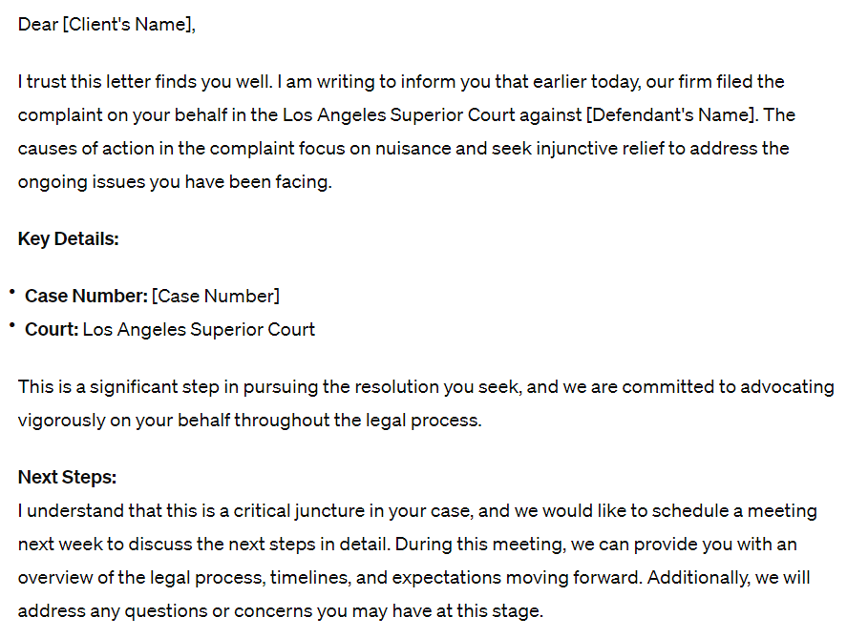
Prompt
Three:
Change
Audience
to Client

Slide 20
Prompt Four: Check for Weaknesses
Draft a one-page memo to law firm partner from associate describing the weaknesses is this case of the homeowner against the HOA on nuisance from the loud noise from the pickleball court.

Slide 21
Prompt Four: Check for Weaknesses

Slide 22
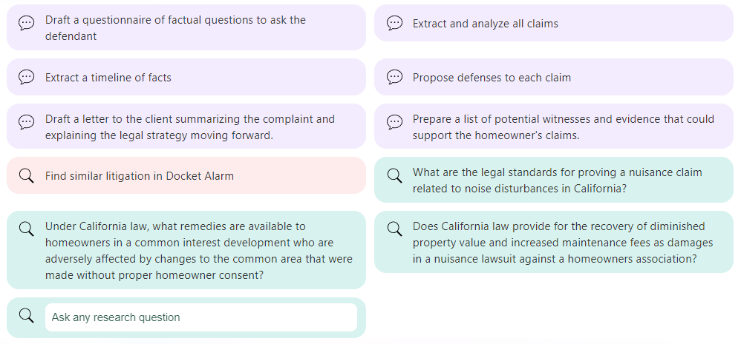
Prompt Four: Use AI to Improve Results

Slide 23

Prompt Four: Don't Forget
Traditional Checks
Use brief analyzer
Cite check
All normal, pre-AI checks

Slide 24
Prompt Five: Change in Situation
HOA is acting at sole request of a board member – an avid pickleball player – does this change anything?
Compile all research, cases, drafts to database and query for comparable situations

Slide 25
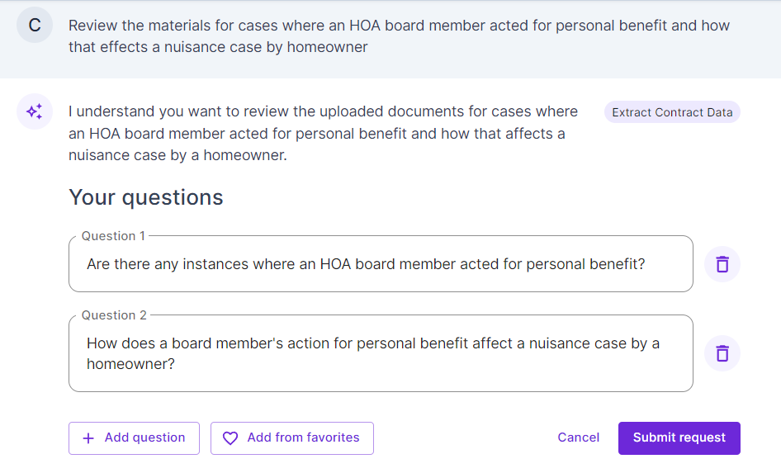
Prompt
Five

Slide 26
Prompt Five: Change the Output
Find cases where HOA board member acted for personal benefit in nuisance case by homeowner in CA
Kashani v Rochman - two HOA board members breached fiduciary duty, acted negligently, benefitted own interests at expense of HOA/members; but Plaintiff lacked evidence
Wave Crest Holdings v Wave Crest Owners Ass'n - dispute within CA HOA, conflicts issue
Cohen v SS Construction Co - duties, liability of developer re nuisance claim, developer can't make decisions for HOA

Slide 28
Situation | Example Prompt
Deposition Prep | Create 10 depo questions on research methodology, PI experience for a bivalve mollusk expert
Contract Review | Are there any confidentiality clauses in any of these commercial real estate leases? (Y/N)
Client Development | Draft a one-paragraph press release on a personal injury trial victory for X firm where defendant not liable as plaintiff was dishonest about ski lift injury
International Arbitration | Translate letter in Italian to English
eDiscovery | Highlight all emails with negative sentiment about Y employer

Slide 29
Takeaways
Write your prompt with the platform, audience, and output in mind
Use conversational queries, but use legal terms in legal tools
Be comfortable trying again as needed
Develop and improve your skills through practice and continuing education

Slide 30
Learn More
Take PLI, LinkedIn Learning, and your institution offered courses on Gen AI, prompt engineering, and more
Attend vendor trainings on their AI offerings, accept demos, and run trials
Read articles from AALL, SCALL, and their members on other platforms to keep up with the rapid changes

Slide 32

Thank you!
Questions?

