Slide 1
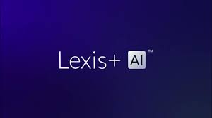
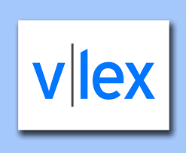
AI SMACKDOWN
SCALL Institute
8 February 2025

Slide 2
Panel
Cindy Guyer, O’Melveny & Myers
Mark Gediman, Alston & Bird
Tanya Livshits, DLA Piper

Slide 3
Please Note
The products presented in this session are for informational purposes only. The inclusion of these products does not imply endorsement, preference, or affiliation with our employers or the vendors. The views and opinions expressed are solely those of the speakers.

Slide 4
Program
Overview of platforms
Evaluation of AI answers
Discussion
Q & A

Slide 5
Lexis+ AI
Launched in 2023
Multi-model, multi-vendor, LLM approach
Capabilities: Ask a legal question, draft full legal documents, summarize cases and statutes, upload your own documents for analysis, drafting, summarization, or to create a database for future use
Trained on: Case law, codes, rules, constitution, agency decisions, Practical Guidance and treatises with human oversight
SOC2-Type I Compliant (Type II expected 2025), independently-trained models with secure, siloed user sessions, and commercial-grade, private cloud infrastructure
Extractive, Generative, and Agentic AI

Slide 6
Lexis+AI Ask
Narrative answer (paragraph(s) or list format)
Just long enough to answer the question fully. Answer length varies greatly between questions
AI answer supported by grounded case law, codes, rules, constitution, agency decisions, Practical Guidance and treatises
Additional related material provided to further support grounded answer
Linked sources easily accessible

Slide 7
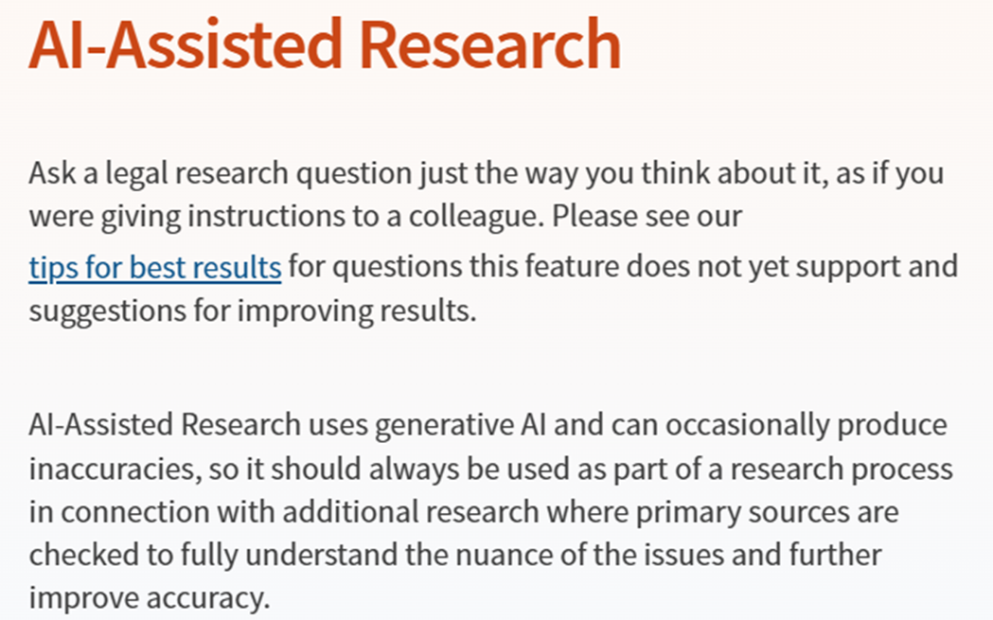
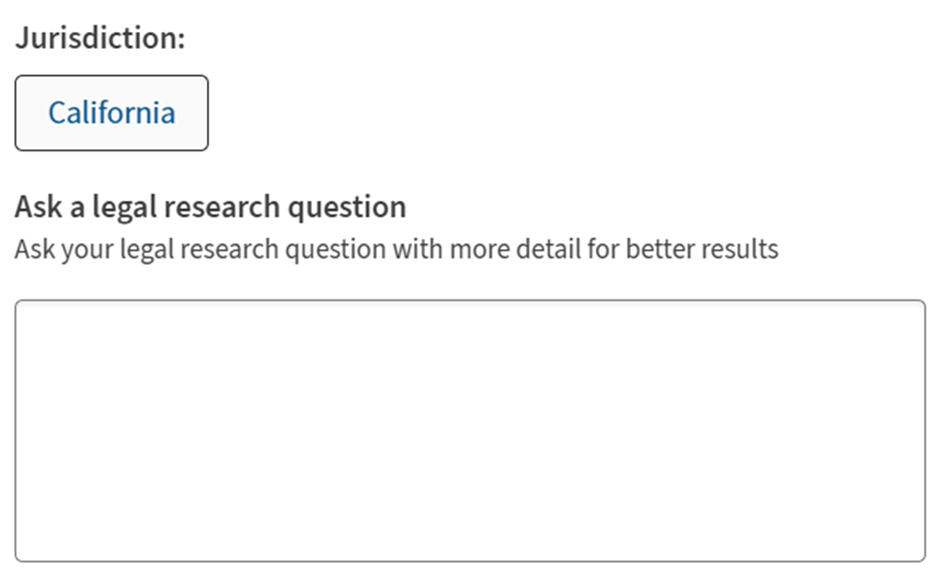
Westlaw Precision – AI Assisted Research

Slide 8
Westlaw Precision – AI Assisted Research
Launched in 2024
LLM(s) unknown (changed in Oct. 2024)
Content trained on primary law and Westlaw editorial enhancements
Private, secured
Natural language processing
“Gold” answers and ongoing assessment

Slide 9
Westlaw Precision – AI Assisted Research
Narrative answer (paragraph(s) or list format)
“Concise” answer (changed from “comprehensive” in Oct. 2024)
AI answer supported by cited primary sources
Additional secondary sources provided
Linked sources easily accessible (possible cost)

Slide 10
vLex – Vincent AI
What can Vincent do?
Answer legal research questions regarding US and selected foreign law (includes EU, UK & China among many others)
Process results quickly most of the time
Good answers to most litigation and statutory questions
50 state survey charts can be downloaded into Excel
Results contain primary, secondary and administrative sources

Slide 11
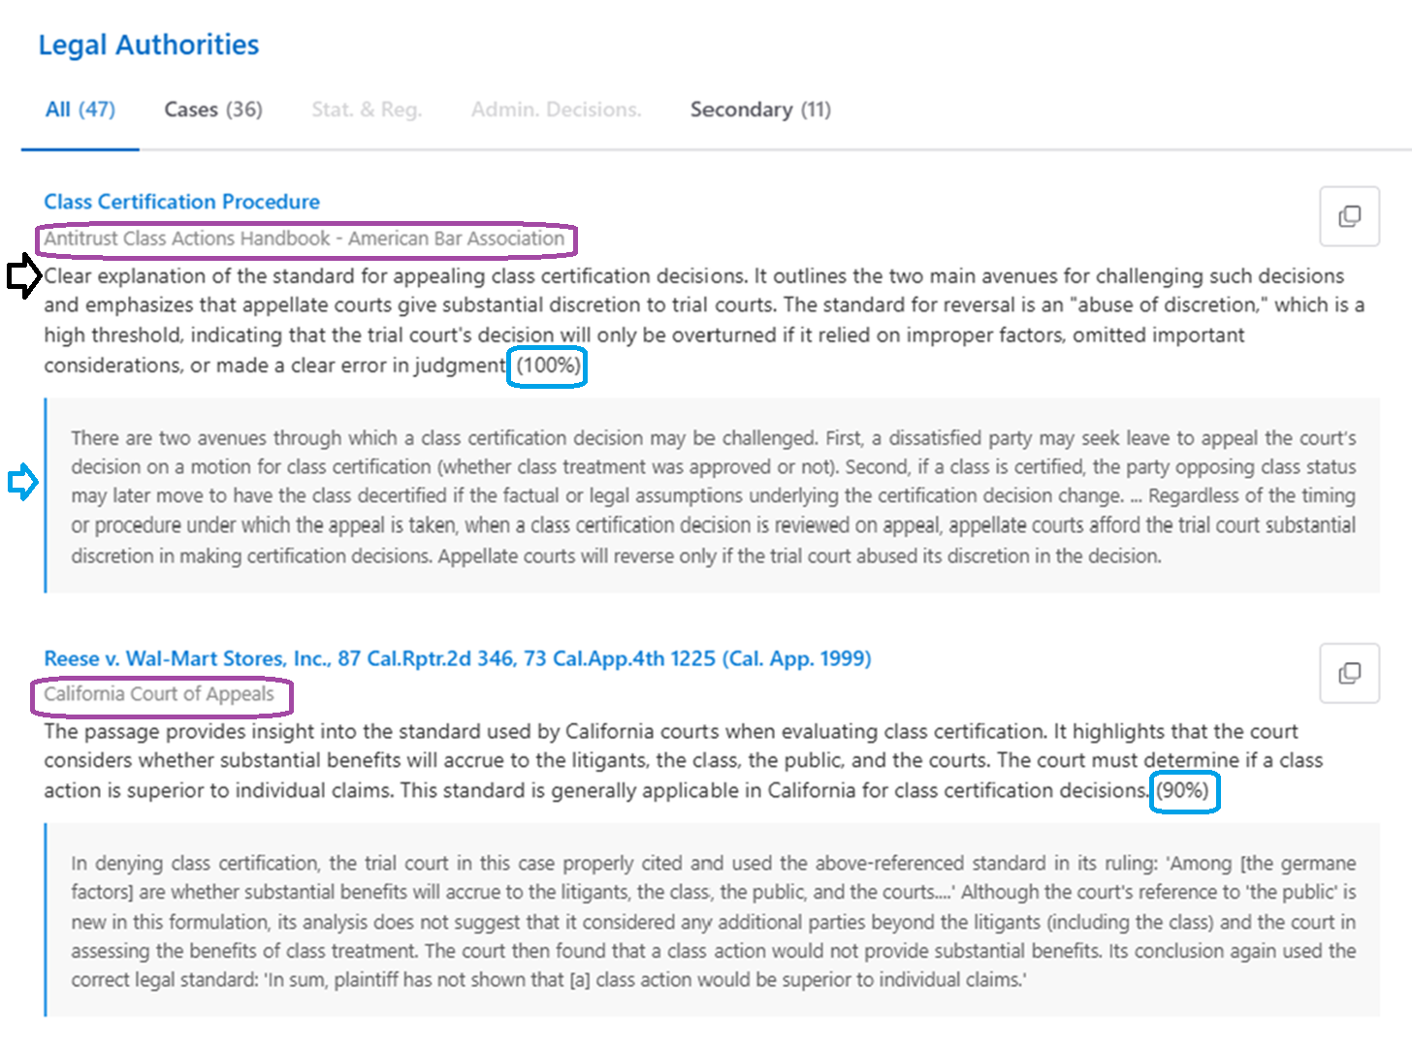
vLex – Vincent AI
Results delivered in multiple formats
Results memo organized clearly and concisely
Short Response
Legislation & Statutes
Case Law
Exceptions & Limitations
Authority is summarized, ranked for relevance and an excerpt of the actual text shown
Requests and uploaded documents are not retained or used for training

Slide 12
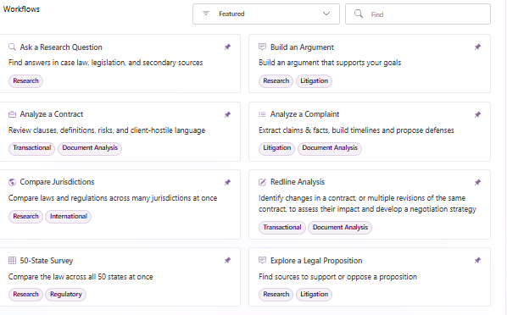
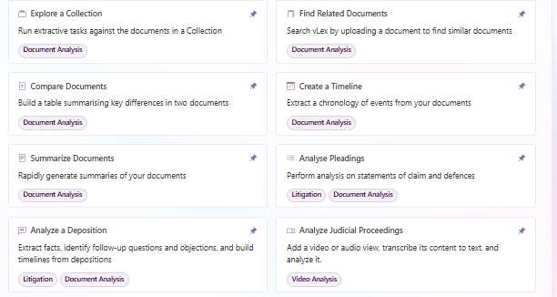
vLex – Vincent AI: Workflows (aka Skills)

Slide 13
Three Questions
What is the time frame to seek certification of an interlocutory appeal from the district court in Ninth Circuit?
Is there a private right of action under the California Reproductive Leave Loss for Employees Act?
What is the standard for appealing class certification? (California)

Slide 14
Evaluation Factors
accuracy of answer
depth of answer
cited primary sources
secondary sources cited
format of answer
iterative options

Slide 15
QUESTION #1
What is the time frame to seek certification of an interlocutory appeal from the district court in Ninth Circuit?

Slide 16
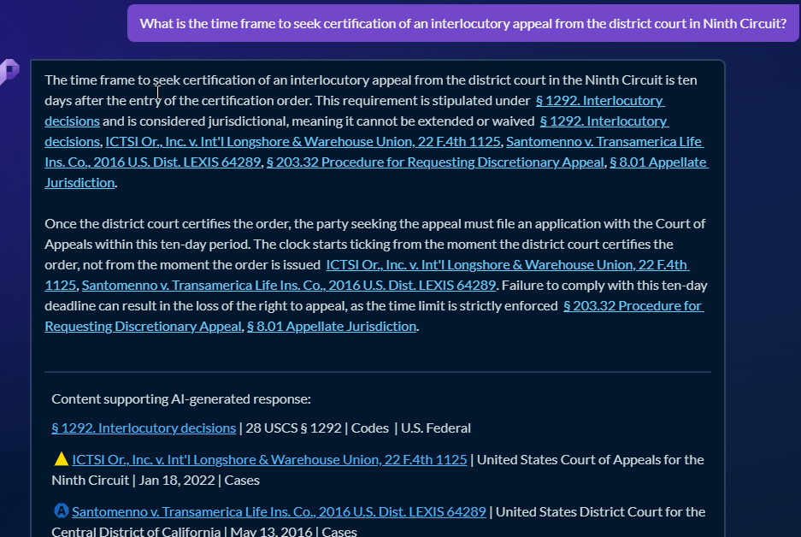
Q #1 Lexis
- correct standard
- In-text cites
- List of sources also set out separately

Slide 17
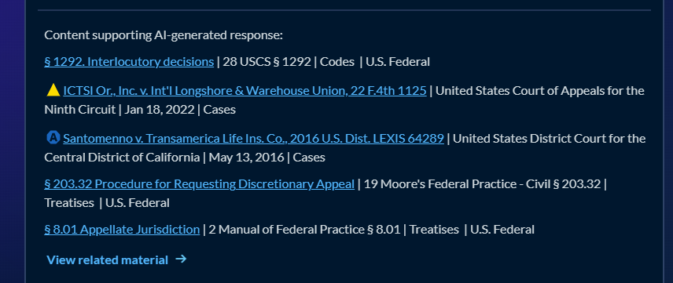
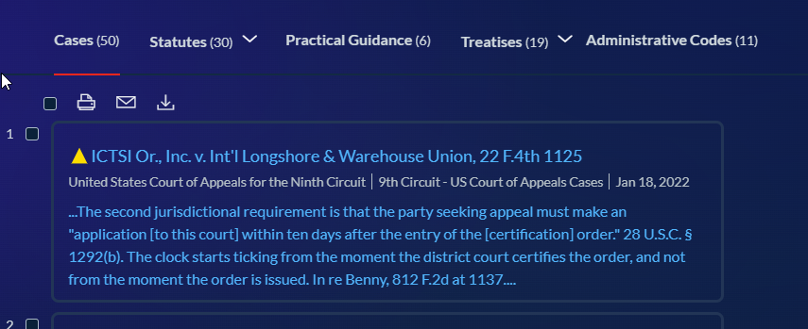
Q #1 Lexis
Cited 5 sources (both primary and secondary) and linked out to 116 additional sources
- Citations are in line next to specific propositions
- Also provided as a list on the result screen but do not pinpoint to where it is discussed
- Linked out to many additional sources (secondary materials and Practical Guidance)

Slide 18
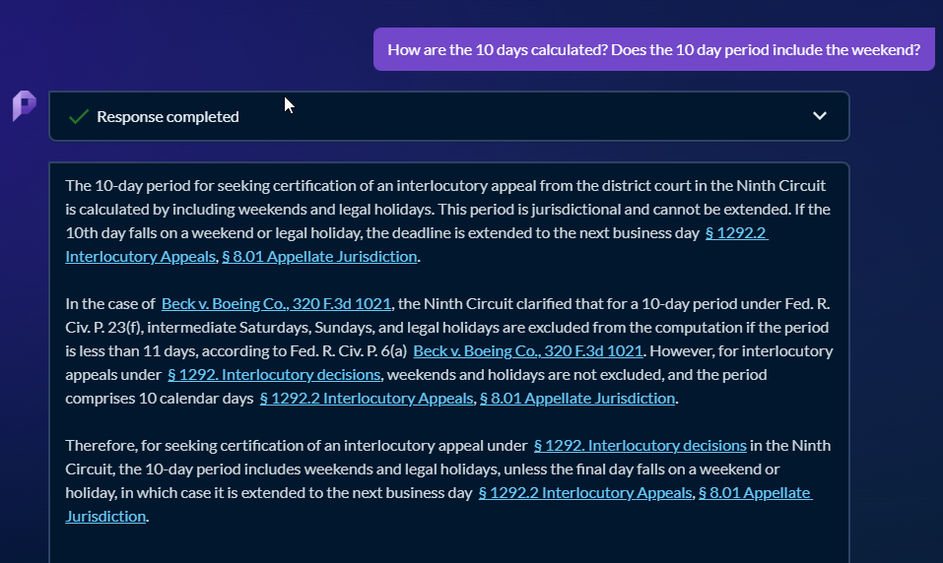
Q #1 Lexis
Follow up questions
Can build out a conversation and ask follow up questions
Starts a new answer with new sources

Slide 19
Q #1 Lexis
Follow up tasks
AI Generated in depth summaries of the cited case law in the answers
An option to quickly get Shepard’s reports on cited authorities
Can ask the same question for a different jurisdiction (a decent alternative to jurisdictional surveys)
Lastly, can convert the answer into a draft memo, which spells out the answer point by point

Slide 20
Q #1 Westlaw
Cited similar authority as Lexis, including same statutory authority and some of the same case law
Answer is substantially the same in content and format

Slide 21
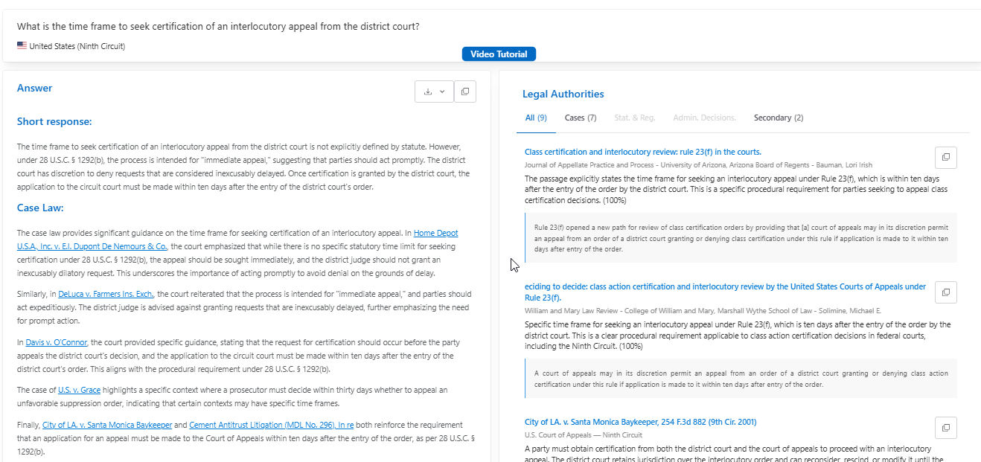
Q #1 Vincent
Arrived at the same guidance but did not cite similar cases
Cited governing statute in answer only

Slide 22
QUESTION #2
Is there a private right of action under the California Reproductive Leave Loss for Employees Act (SB848)?

Slide 23
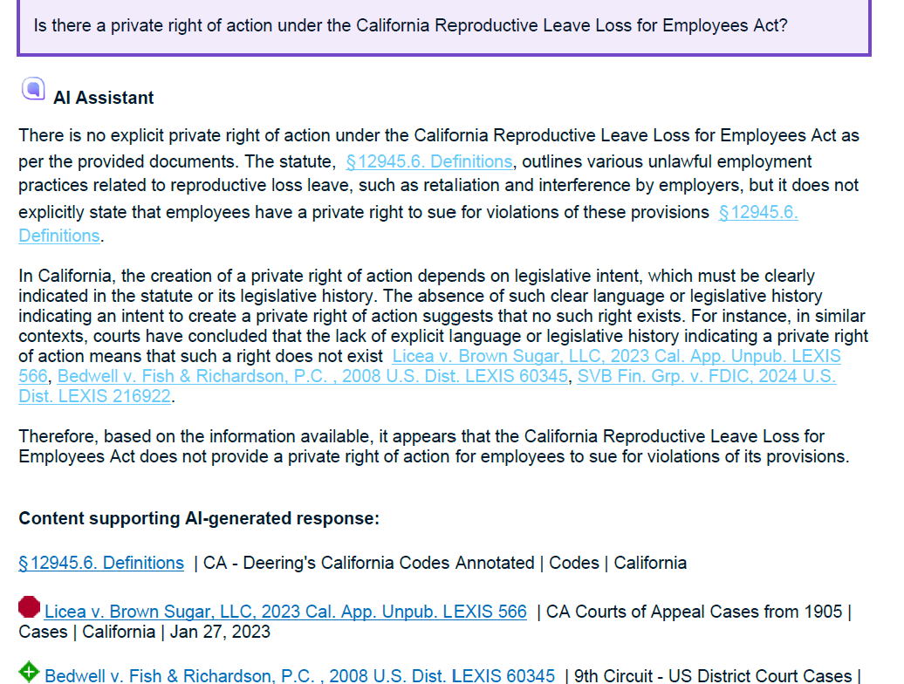
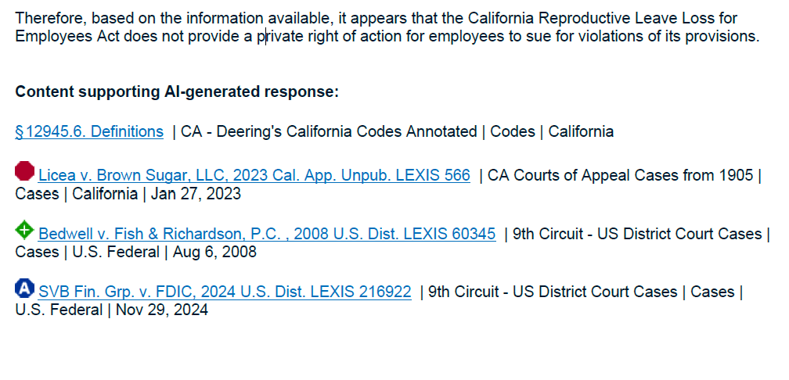
Q #2 Lexis
Concludes no private right of action

Slide 24
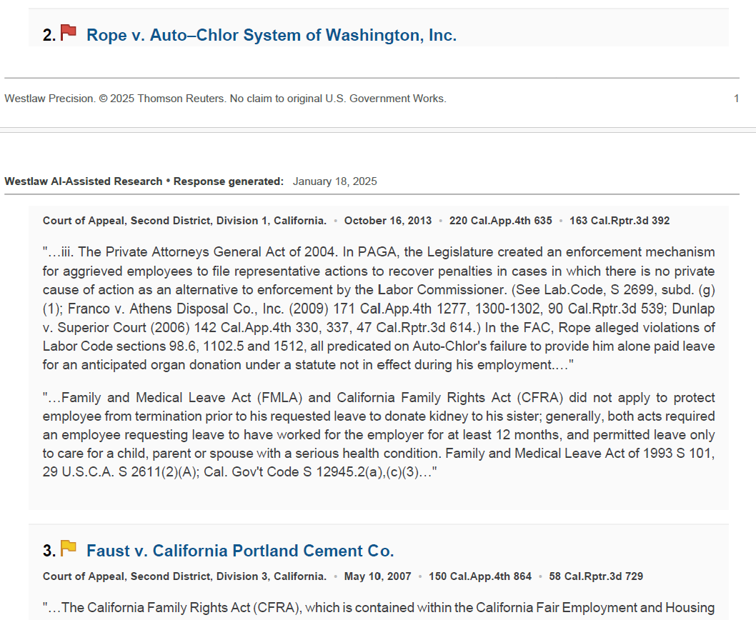
Q #2 Westlaw
No explicit private right of action
Allows for a possible right of action under PAGA

Slide 25
Q #2 Vincent
Code added in 2024.
Different Conclusion than Lexis & Westlaw.
Interprets language in Ca. Gov. Code § 12945.6 (where act is codified):
It’s an arguable assumption but not explicitly stated
Found a regulation section that may apply.

Slide 26
QUESTION #3
What is the standard for
appealing class certification?
(California)

Slide 27
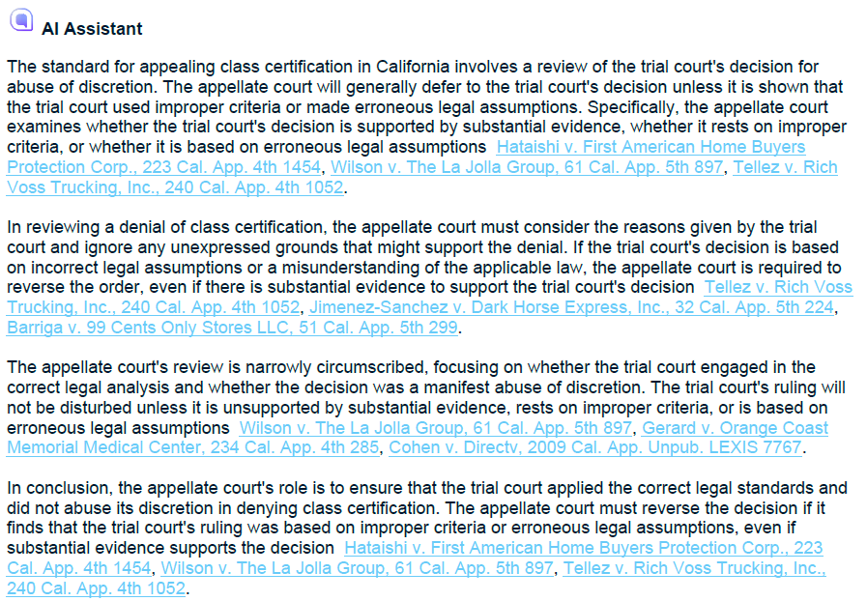
Q #3 Lexis
- correct standard - in-text cites
- repetitive info and sources
- no “death knell” warning

Slide 28
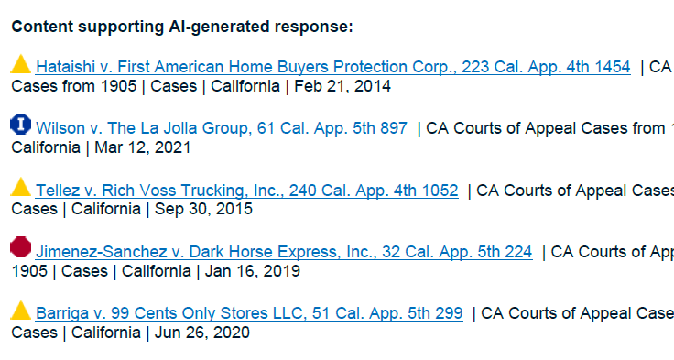
Q #3 Lexis
Cited primary law with no text excerpts
7 primary law sources in exported answer
Additional 91 relevant primary law sources, organized by type

Slide 29
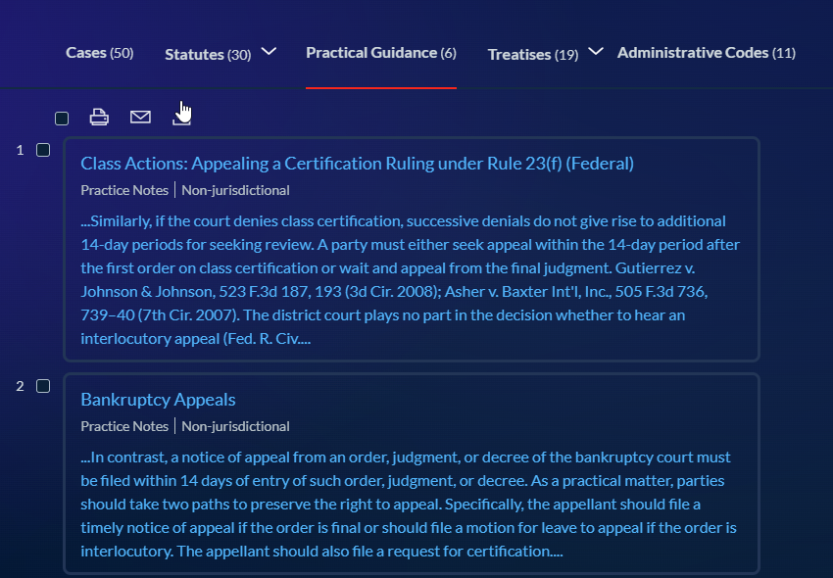
Q #3 Lexis
Secondary sources
(19 treatises and 6 Practical Guidance)
some sources not relevant (focused on federal)
downloadable by selecting documents (separate from answer)

Slide 30
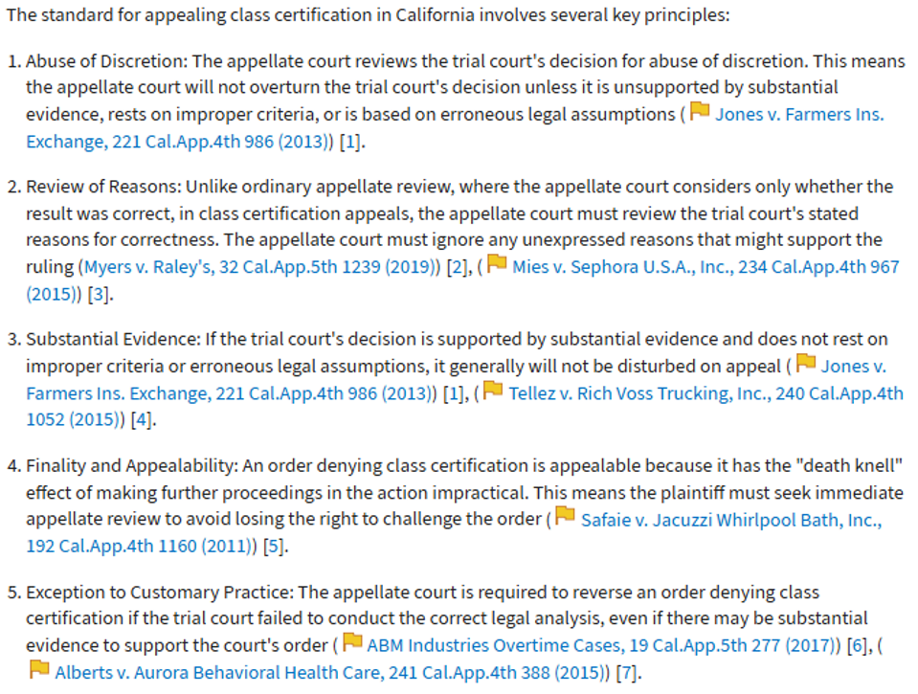
Q #3 Westlaw
- correct standard
- FN and in-text cites
- list format (elements? confusion?)

Slide 31
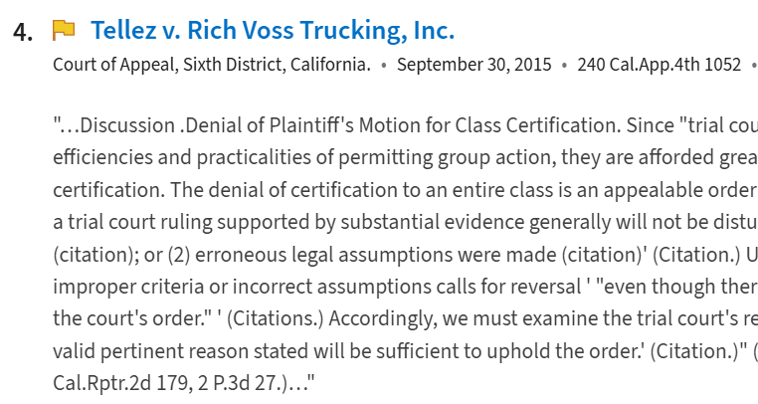
Q #3 Westlaw
Cited primary law with text excerpts
(15 cited, plus 7 “show more results” = 22)

Slide 32
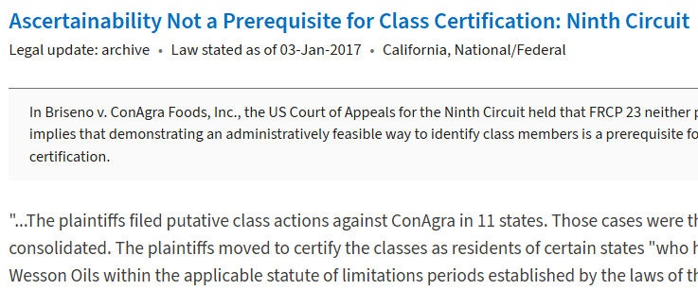
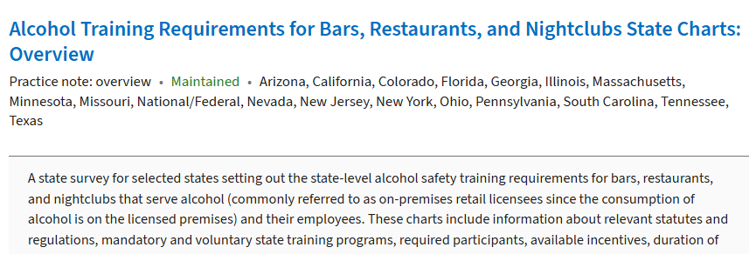
Q #3 Westlaw
Secondary sources
(6 sources, relevancy varies)

Slide 33
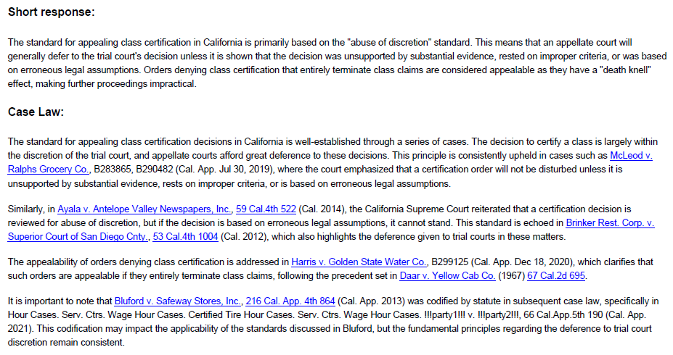
Q #3 Vincent AI
- correct standard
- in-text cites
- no citator symbols
- most depth
- sectioned answer

Slide 34
Q #3 Vincent AI
answer continued...
- related info
(i.e., practice notes)

Slide 35
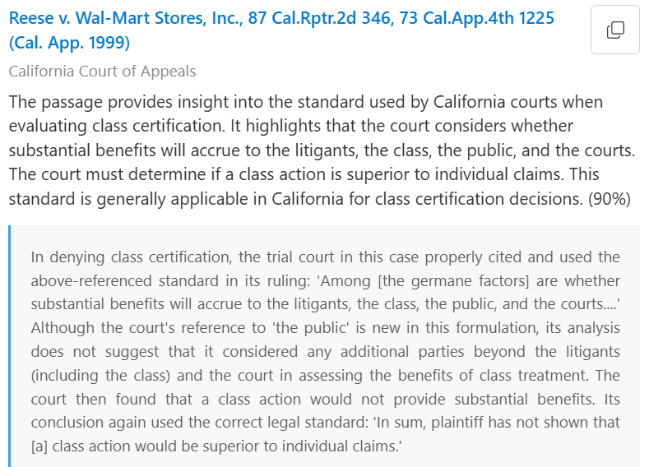
Q #3 Vincent AI

Slide 36
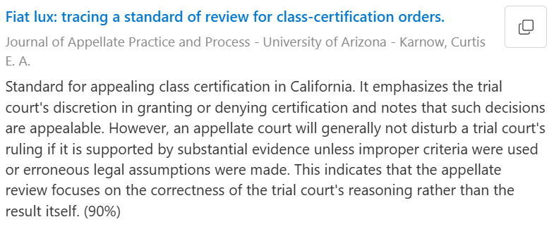
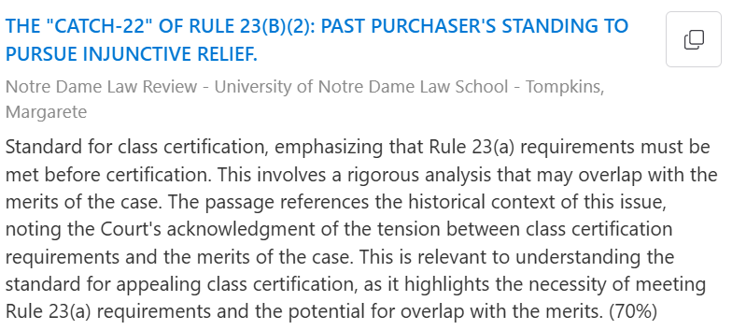
Q #3 Vincent AI
Secondary sources
(11 sources, relevancy varies)

Slide 37
Q #3 Vincent AI
Collaborative ability (clients and other firms)
(anyone with subscription)
This memo was compiled by Vincent AI based on vLex materials available as of January 23, 2025. View full answer on vLex
hyperlinked

Slide 38
Evaluation Factors
accuracy
depth
cited sources
secondary sources
format
iterative options
Yes
medium depth
22
6 (some irrelevant)
paragraphs and list
follow-up questions
WL
Yes
least depth
91
25 (some irrelevant)
paragraphs
most options for users
LX
Yes
most depth
36
11 (most federal)
paragraphs in sections
modify source lists, follow-up questions
VLEX

Slide 39
QUESTIONS

Slide 40
Thank You!

