Slide 1
30 Sites in 30 Minutes AI and Beyond
Loyd Auerbach, LexisNexis
Tina Dumas, Nossaman LLP

Slide 2
Current awareness / keeping up with AI

Slide 3
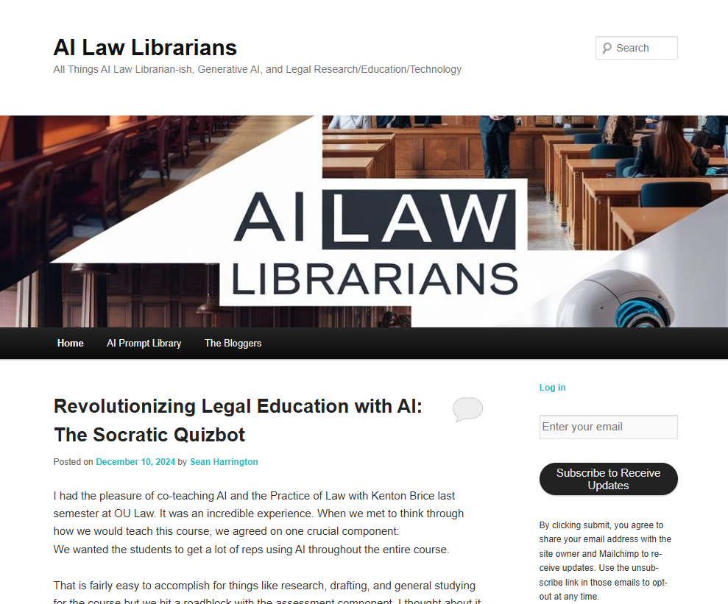
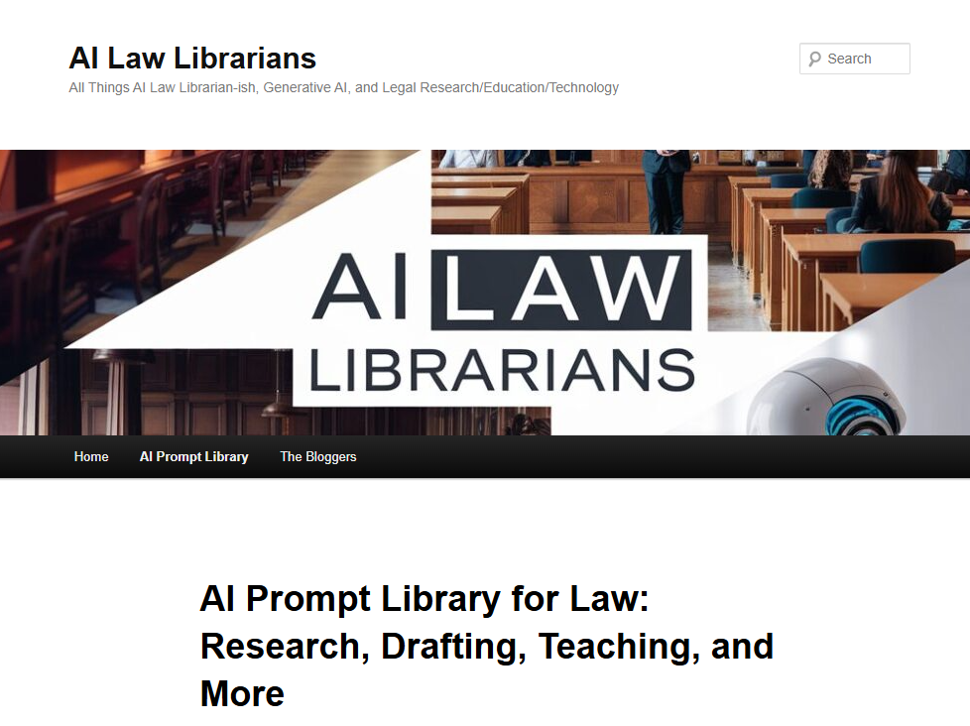
AI Law Librarians https://www.ailawlibrarians.com/
Be sure to check out their prompt library: https://www.ailawlibrarians.com/prompt-library/

Slide 4
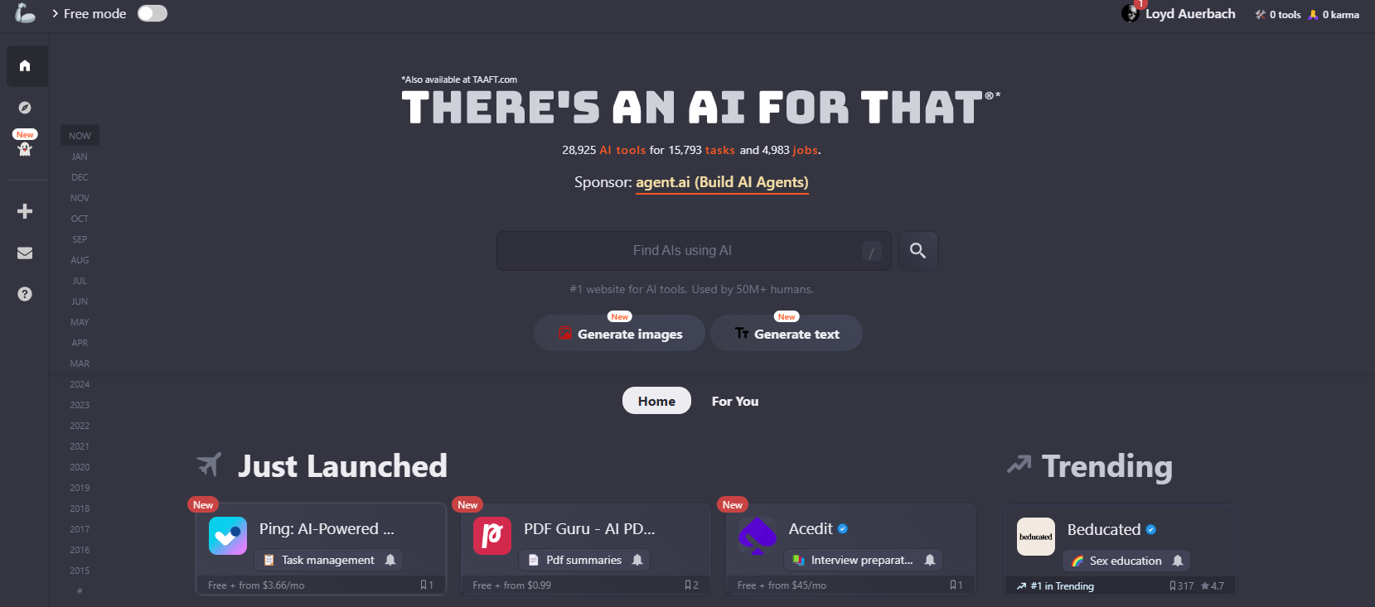
There’s an AI for That https://theresanaiforthat.com/

Slide 5
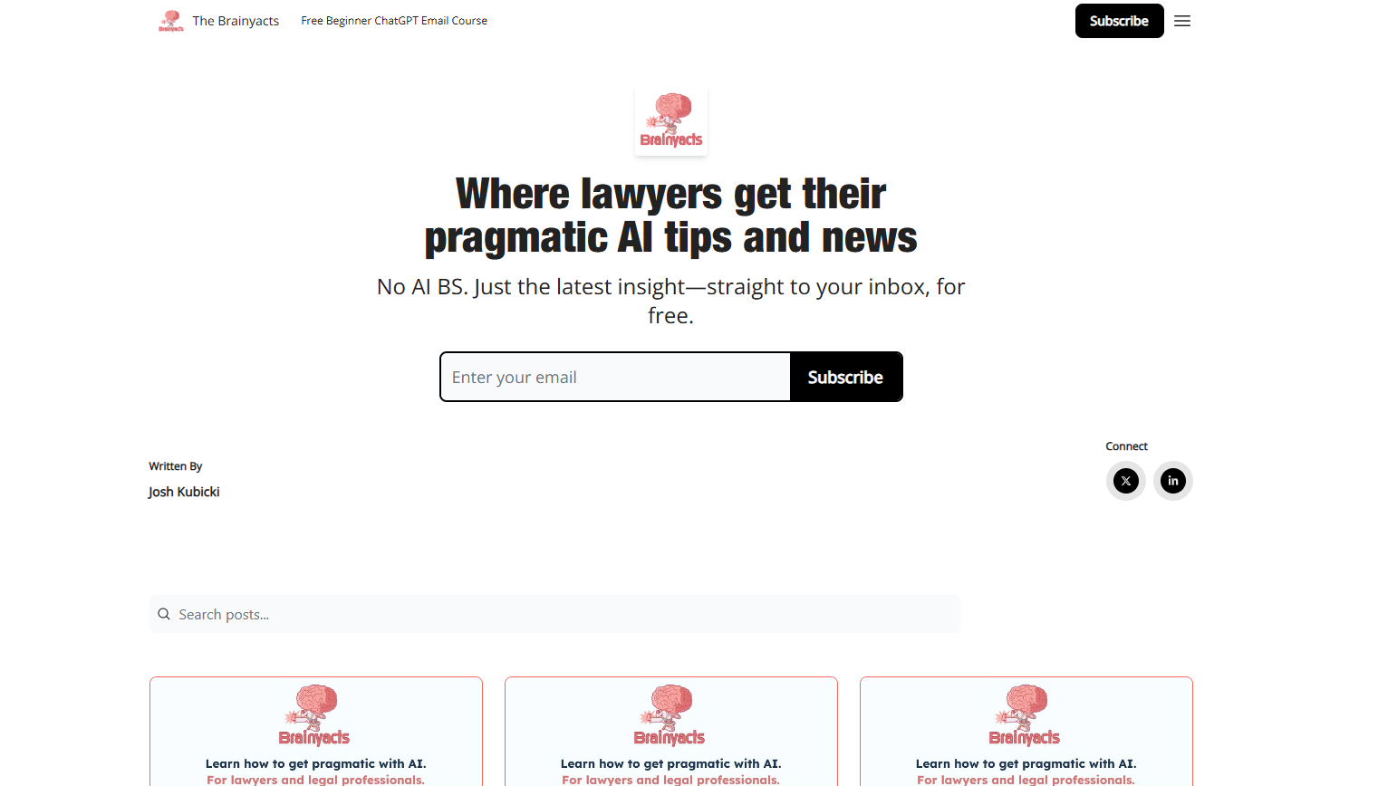
Brainyacts https://thebrainyacts.beehiiv.com/
A GREAT FOLLOW-UP PROMPT FROM BRAINYACTS NEWSLETTER
Based on your previous response, please identify the key areas or concepts in your reply that I can adjust or refine to change the outcome. Highlight any specific words, phrases, or ideas that, if clarified or altered, would significantly impact the direction or depth of your next response. Please also suggest potential “dials” or “knobs” I can turn, such as:
• Increasing or decreasing the level of detail or specificity.
• Shifting the tone (e.g., more formal, casual, technical, creative, etc.).
• Focusing on a different aspect of the topic (e.g., a narrower or broader scope).
• Elaborating on particular areas that were mentioned but not fully explored.
• Providing examples, analogies, or further explanations to clarify the response.
By using this prompt, you’ll be able to guide most generative AI tools to deliver answers that are more aligned with your exact needs—without needing to re-prompt endlessly or start from scratch.

Slide 6
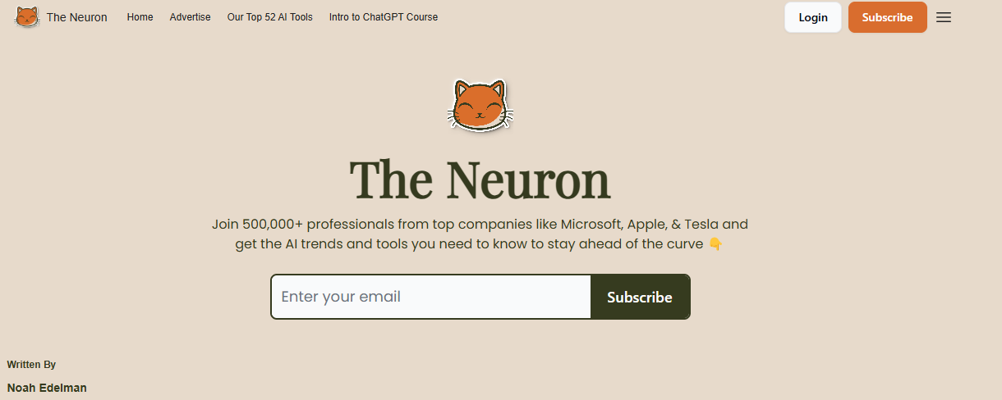
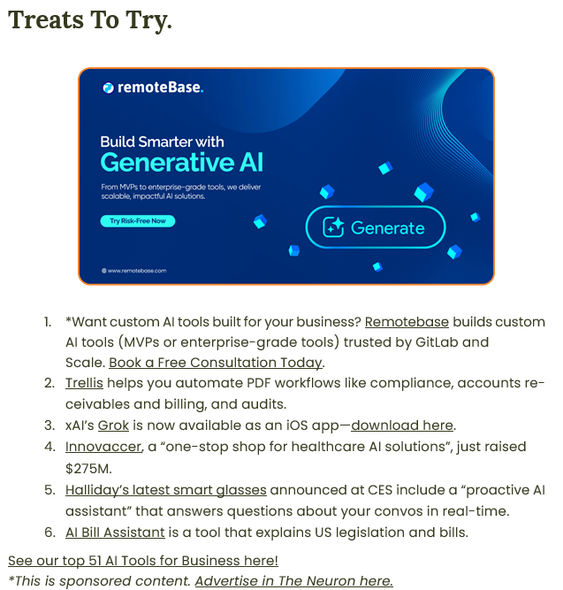
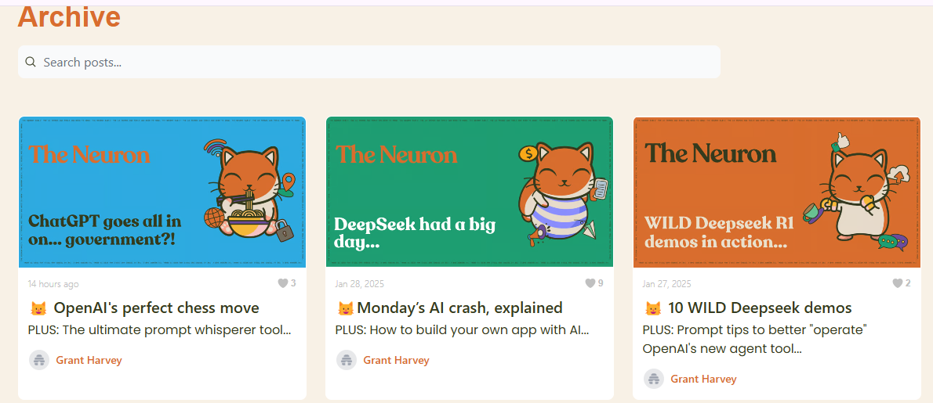
The Neuron https://www.theneurondaily.com/

Slide 7
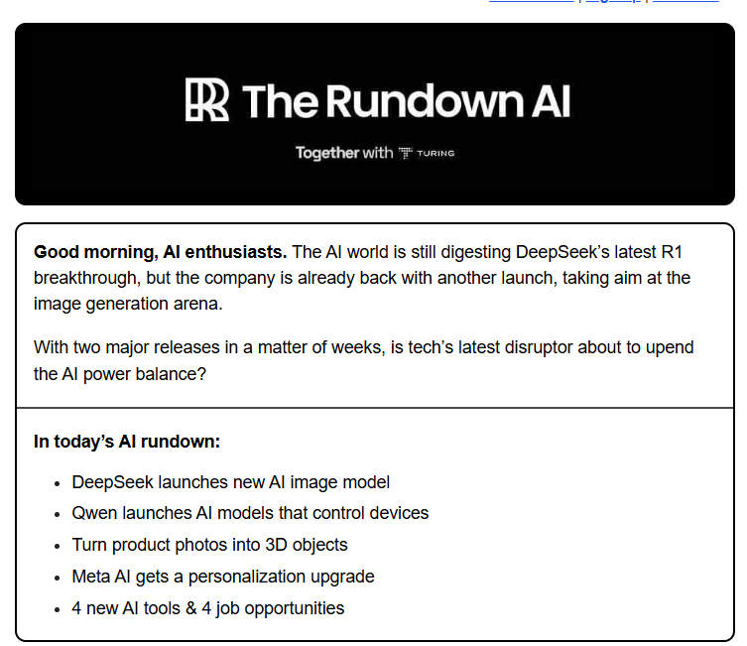
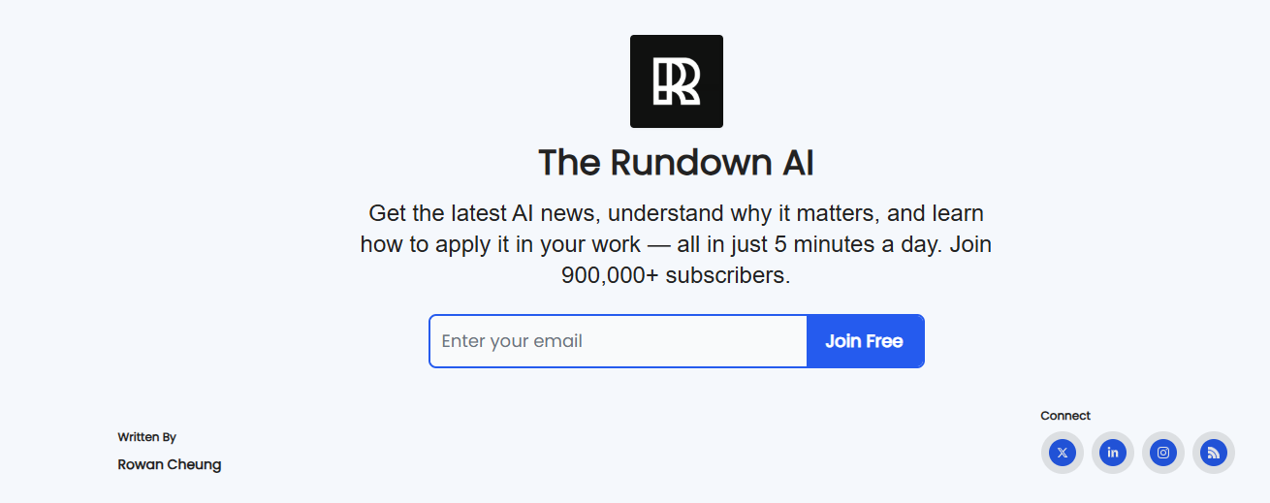
The Rundown AI https://www.therundown.ai/

Slide 8
Websites / Apps

Slide 9
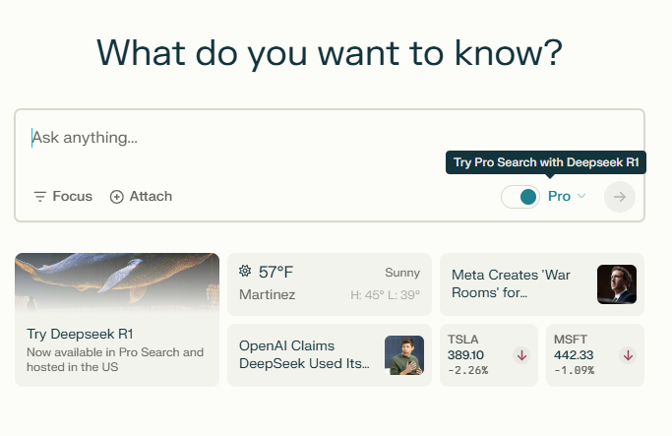
Perplexity https://www.perplexity.ai/
My favorite AI chatbot/search (for now)
Can be anonymous
Free or paid version
Data is up-to-date
Answers are backed by citations
Iphone and Android apps

Slide 10
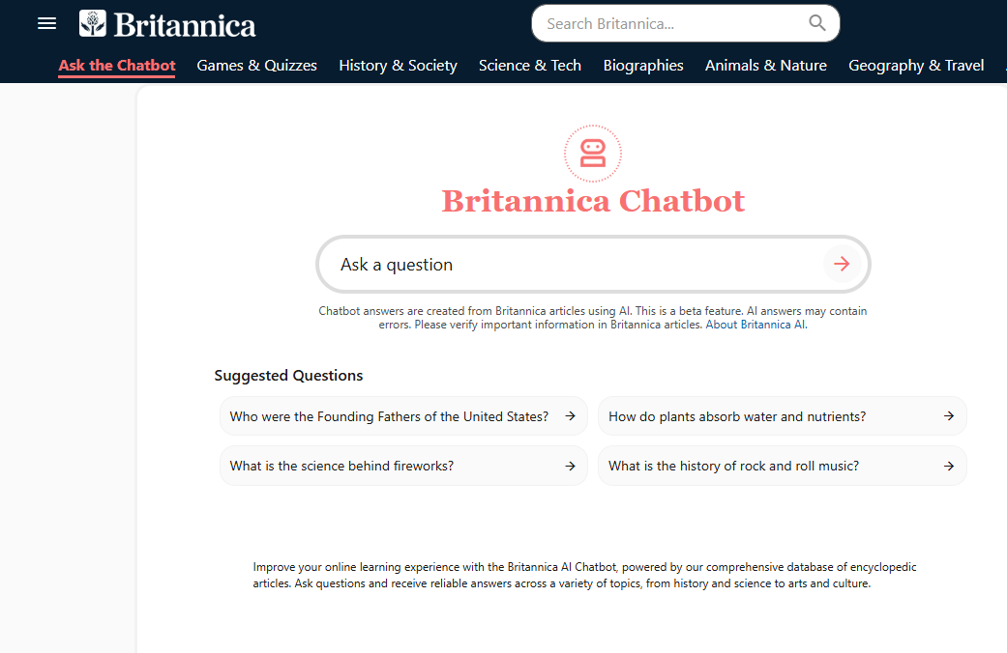
Britannica AI Chatbot
https://www.britannica.com/chatbot

Slide 11
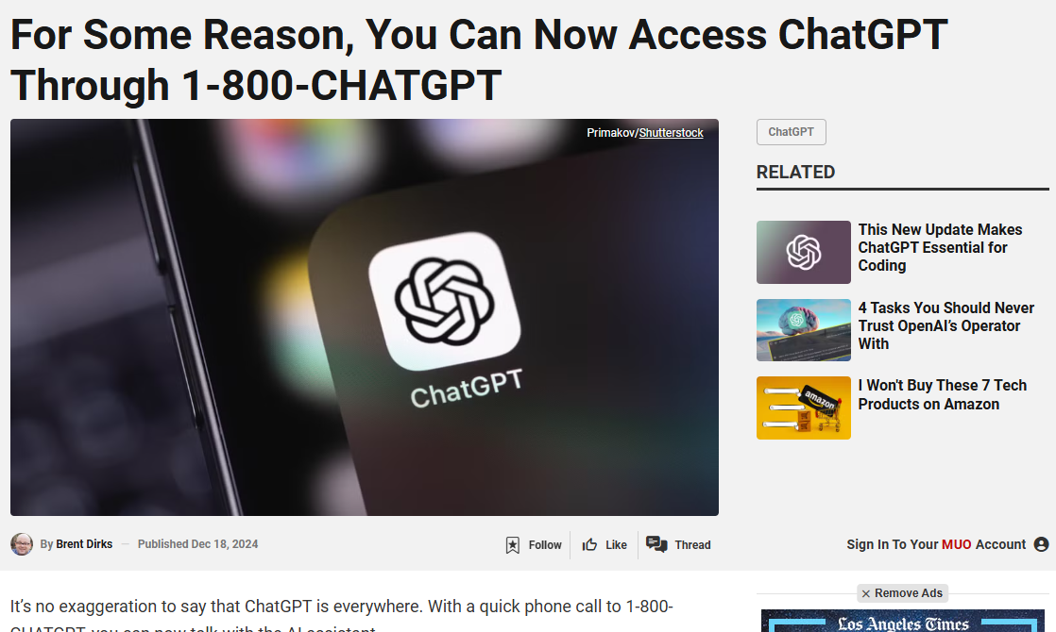
1-800-CHATGPT, you can now talk with the AI assistant.
https://www.makeuseof.com/access-chatgpt-1800chatgpt/

Slide 12
Every AI Copyright Lawsuit in the US, Visualized | WIRED https://www.wired.com/story/ai-copyright-case-tracker/

Slide 13
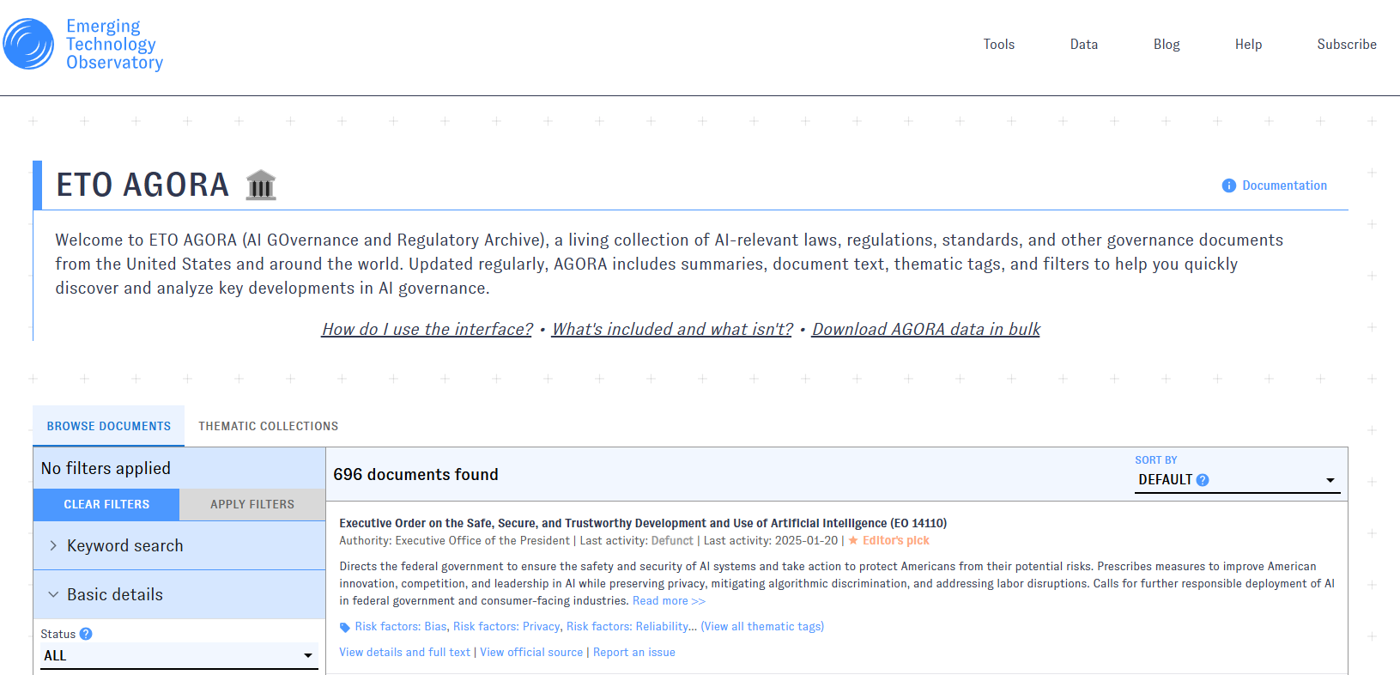
ETO AGORA https://agora.eto.tech/

Slide 14
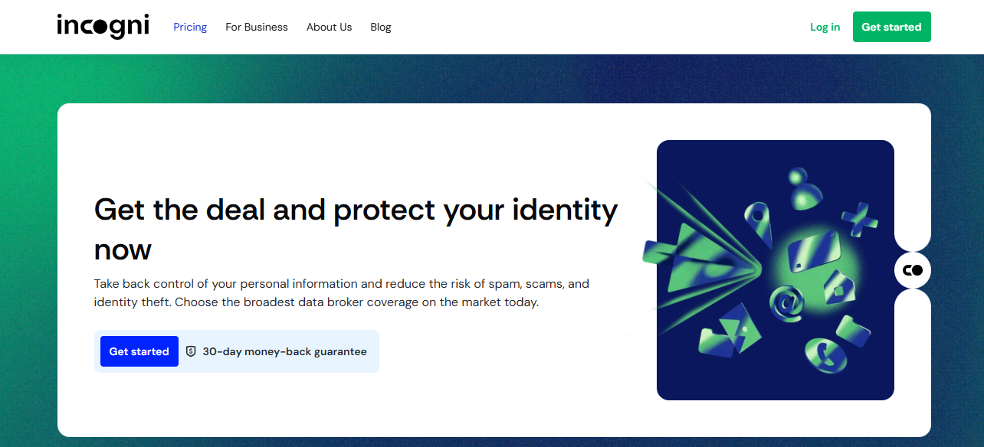
incogni https://incogni.com/
Control your online presence - Data Privacy

Slide 15
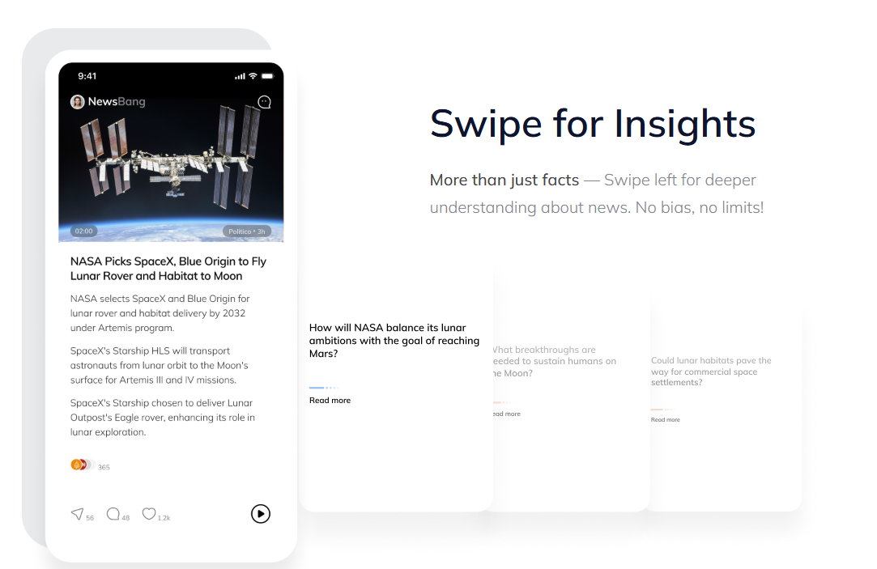
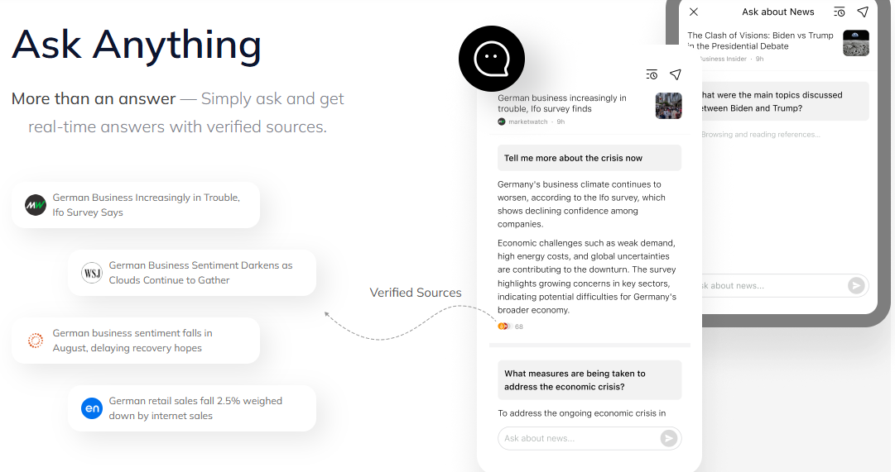
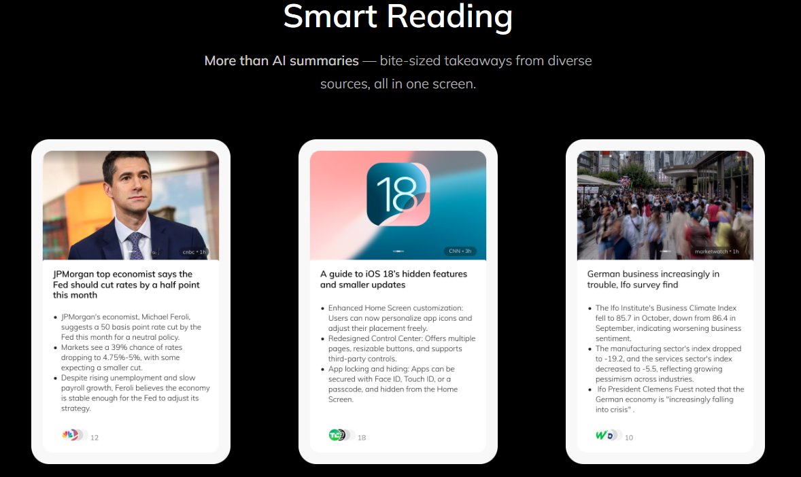
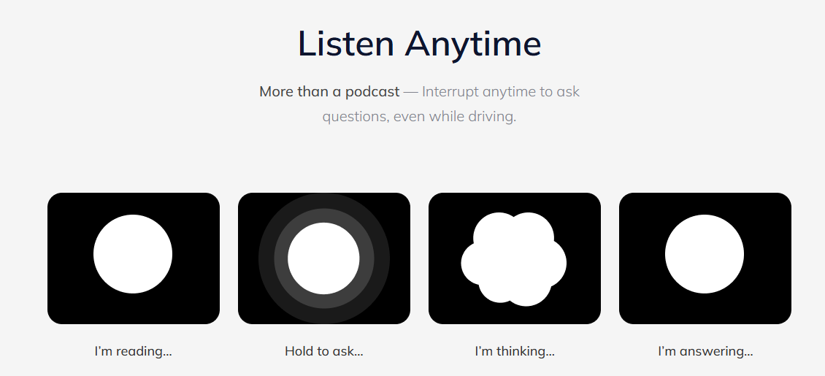
Newsbang https://www.newsbang.com/

Slide 16
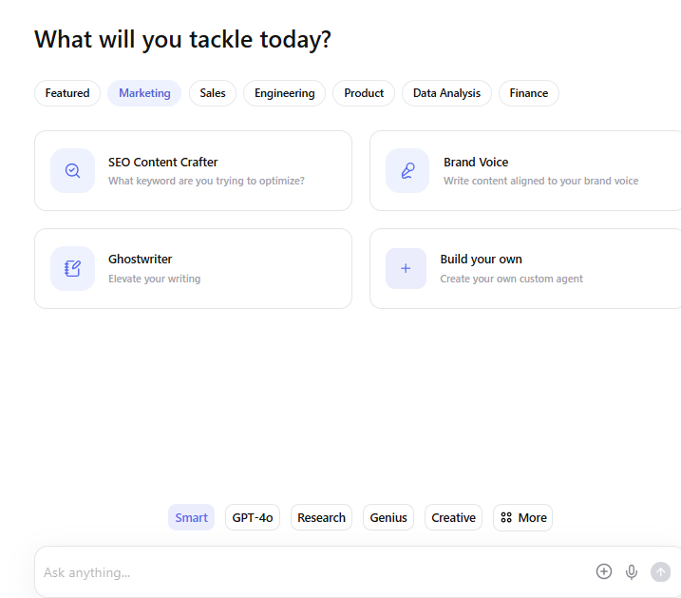
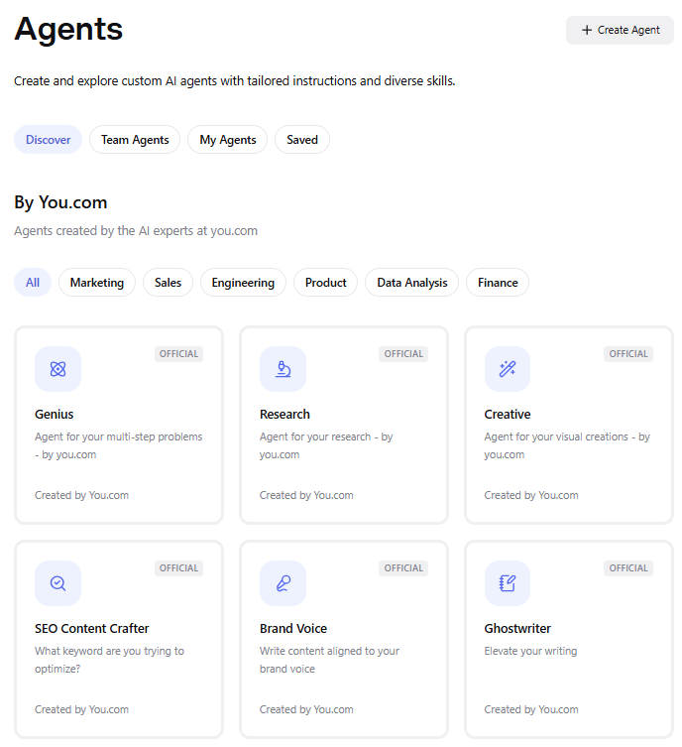
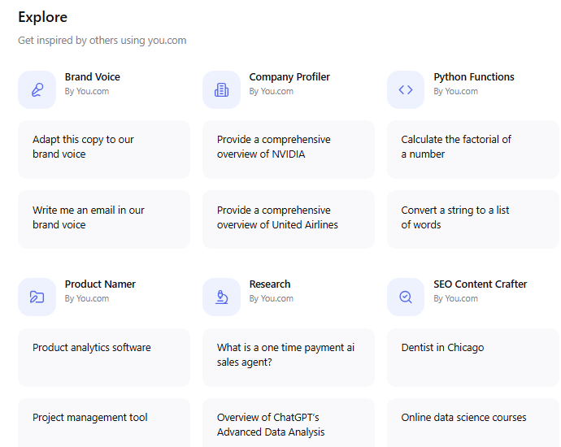
You.com https://you.com
AI Chat, advanced research, visual images & infographics, writing, and much more

Slide 17
AI detection sites and apps

Slide 18
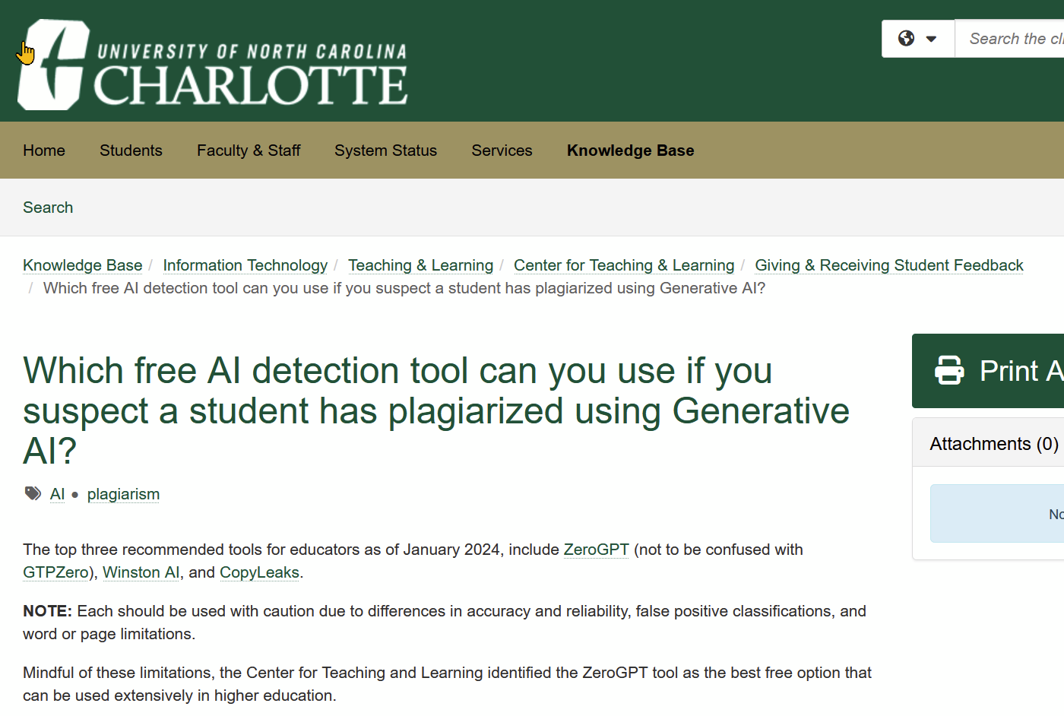
Recommended by Univ North Carolina (https://services.help.charlotte.edu/TDClient/33/Portal/KB/ArticleDet?ID=2787 )

Slide 19
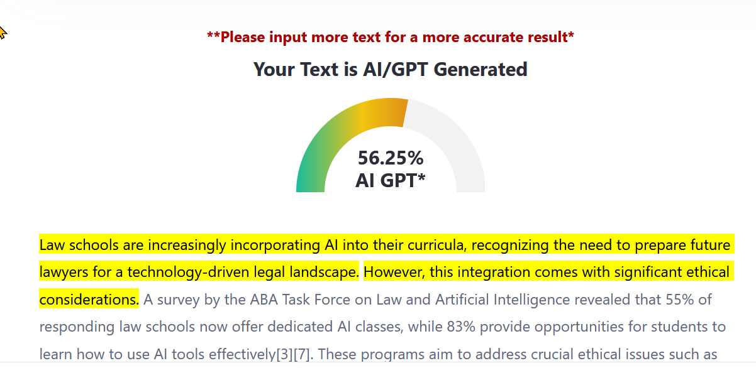
ZeroGPT https://www.zerogpt.com/ (best, but see pros/cons)

Slide 20
Zero GPT
Cons:· Mixed accuracy and reliability: 20% margin of error for false positives (i.e. false accusations of plagiarism)
Pros:
Developed for academic settings,
Free version available,
Probability report,
Highlights suspected text,
Batch-file uploads (no limit),
Chrome Extension

Slide 21
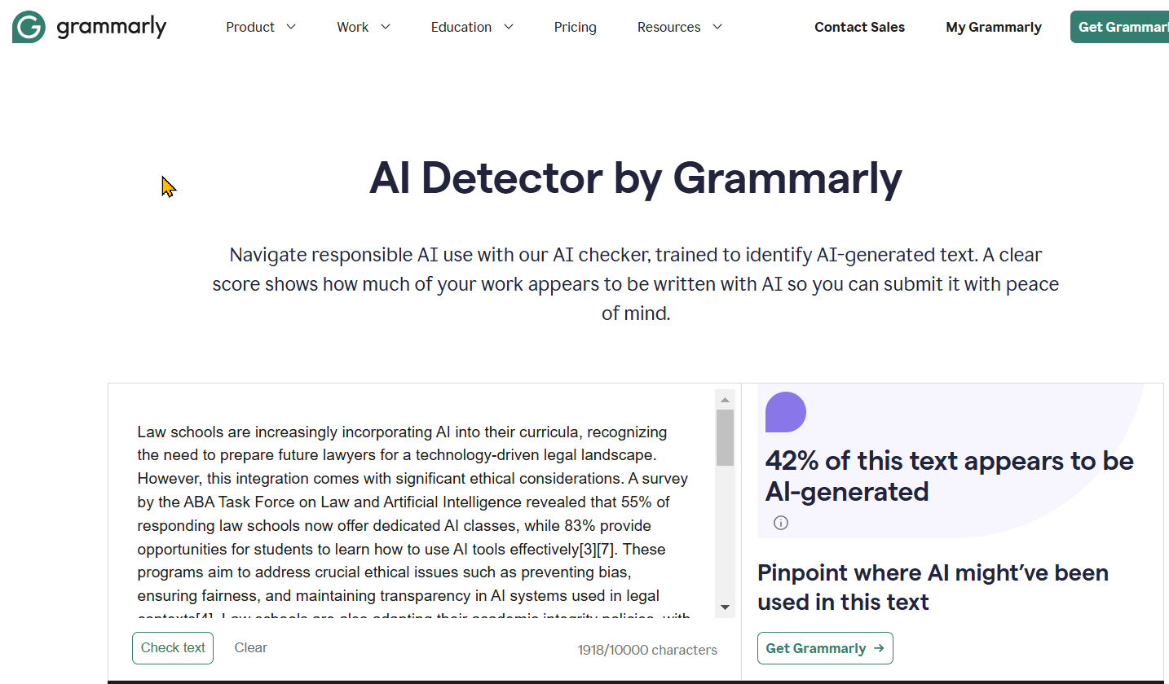
Grammarly AI Detector https://www.grammarly.com/ai-detector

Slide 22
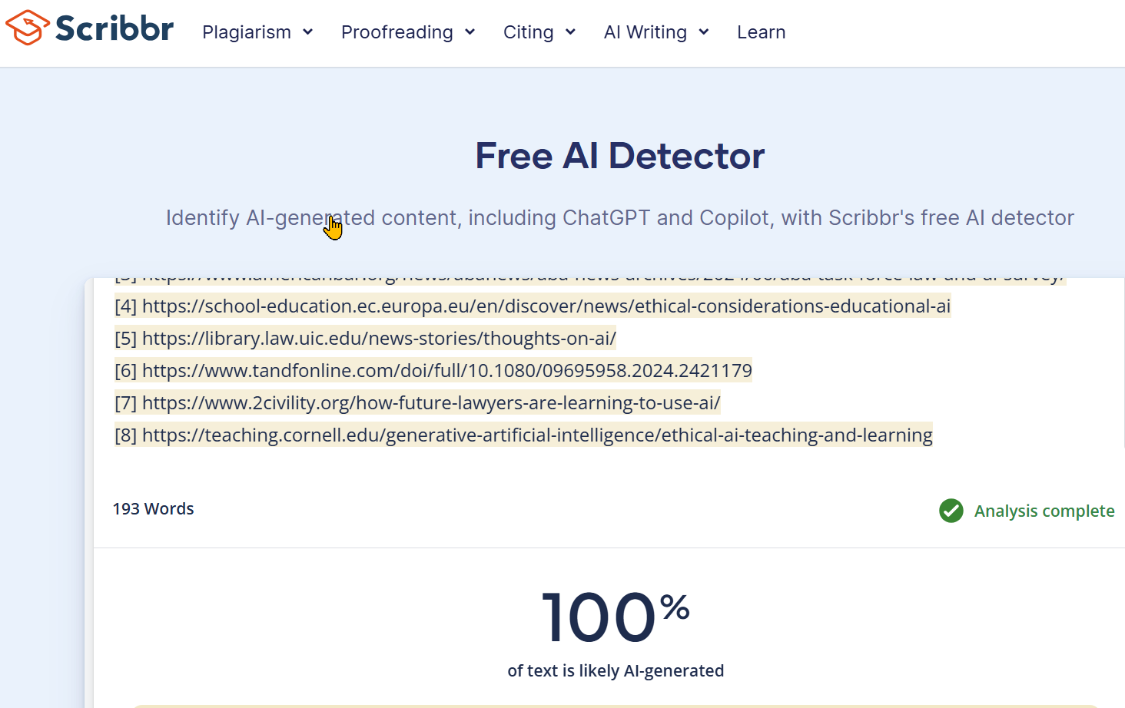
Scribbr https://www.scribbr.com/ai-detector/

Slide 23
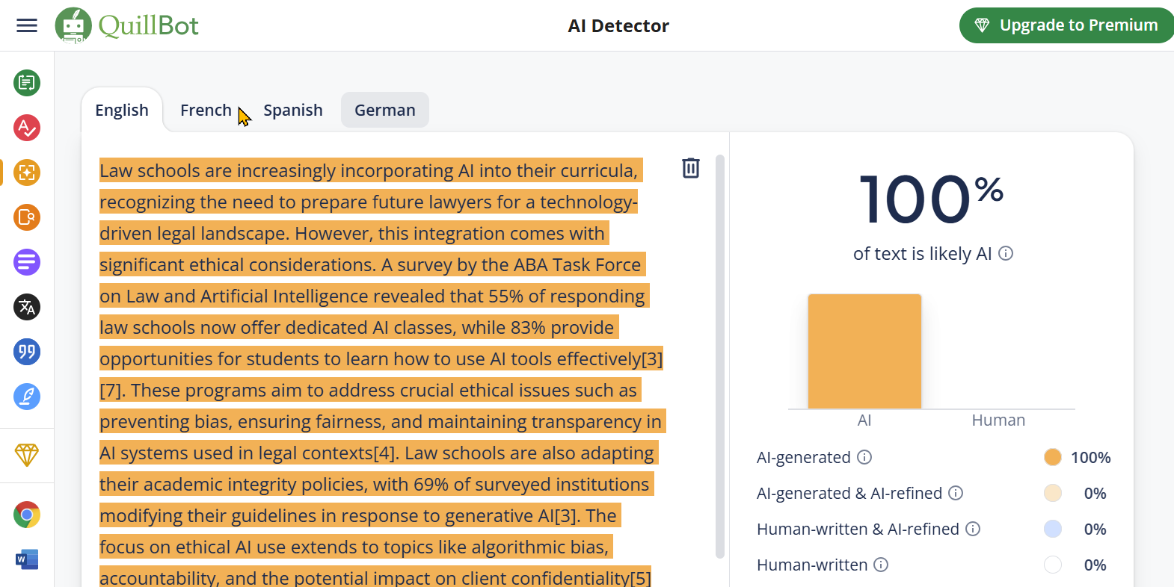
QuillBot https://quillbot.com/ai-content-detector

Slide 24
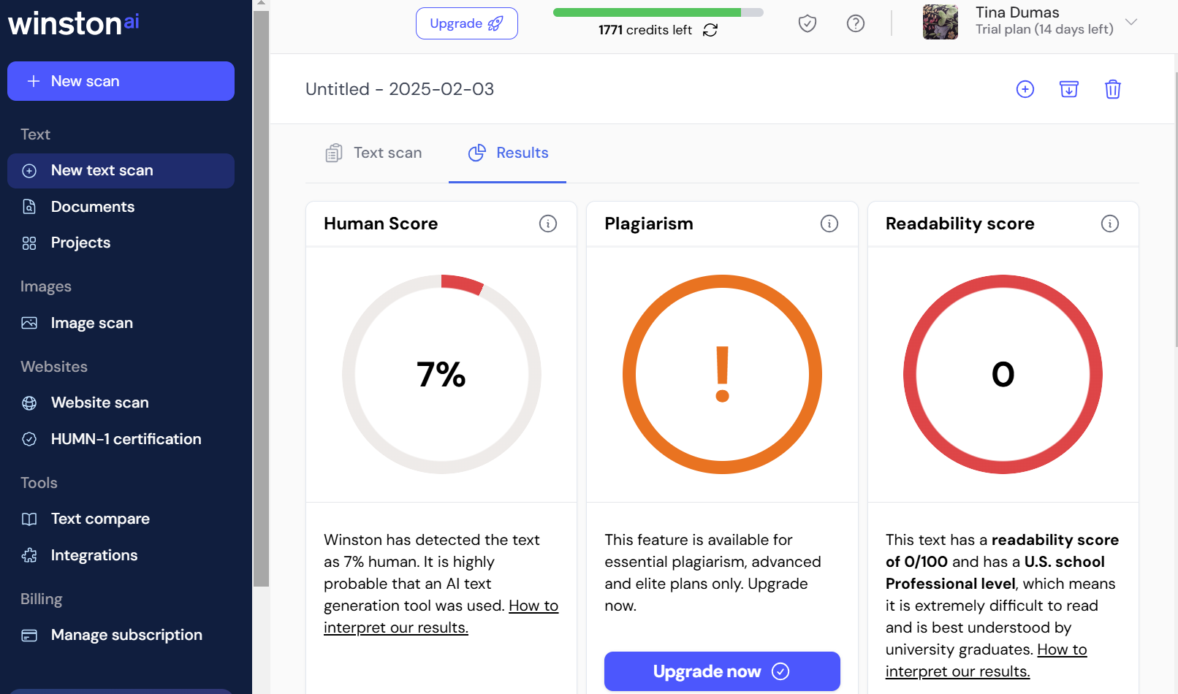
winston ai https://gowinston.ai/

Slide 25
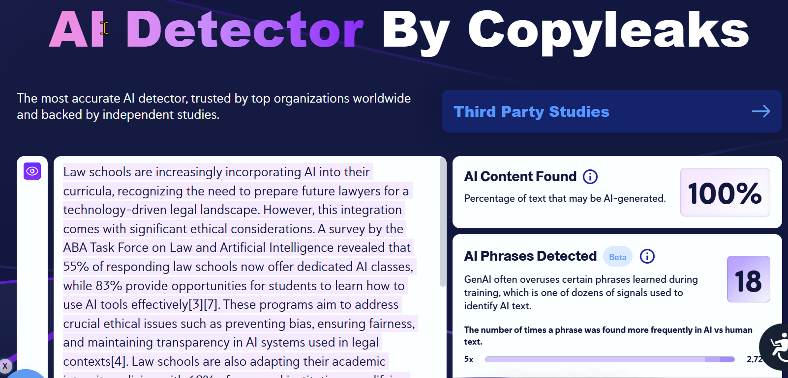
AI Detector by Copyleaks https://copyleaks.com/ai-content-detector

Slide 26
Cool AI Tools

Slide 27
NotebookLM https://notebooklm.google.com/

Slide 28
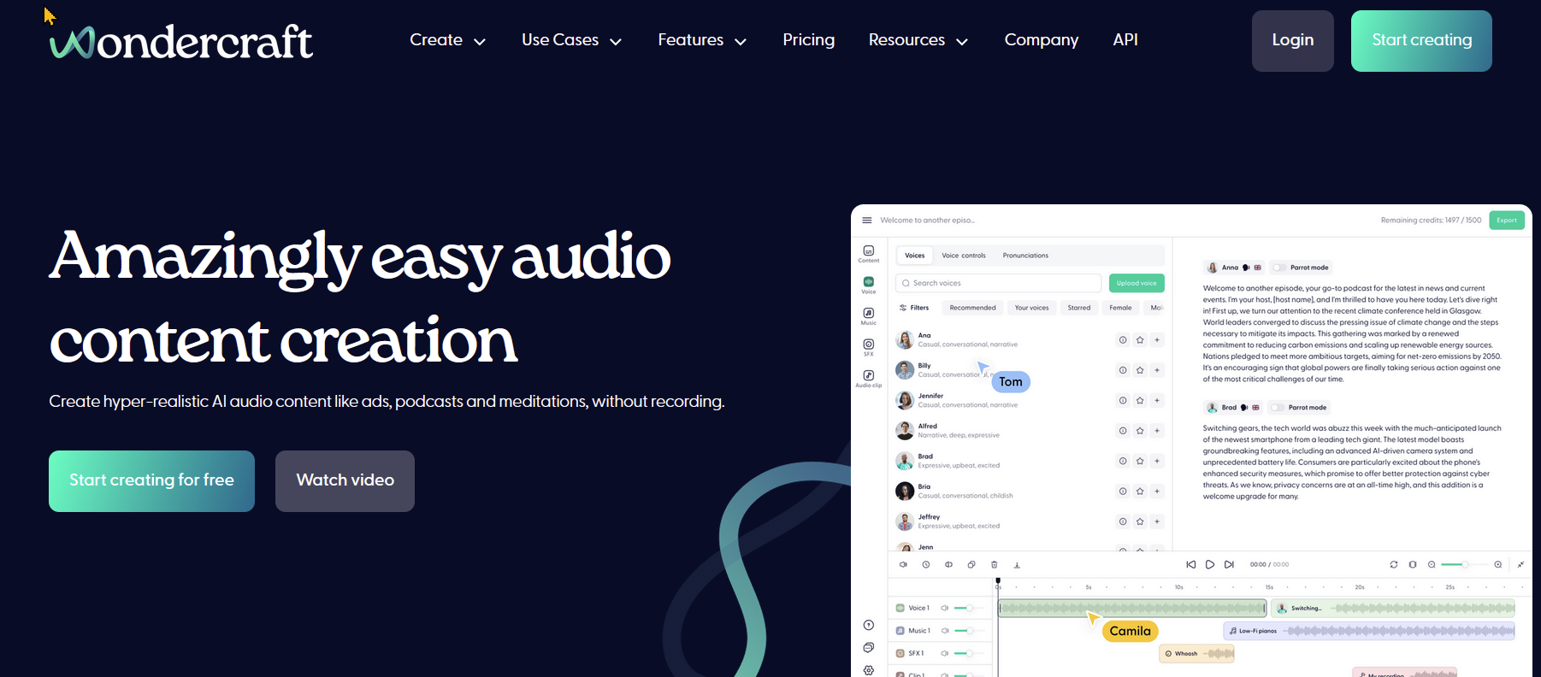
Wondercraft.ai https://www.wondercraft.ai/

Slide 29
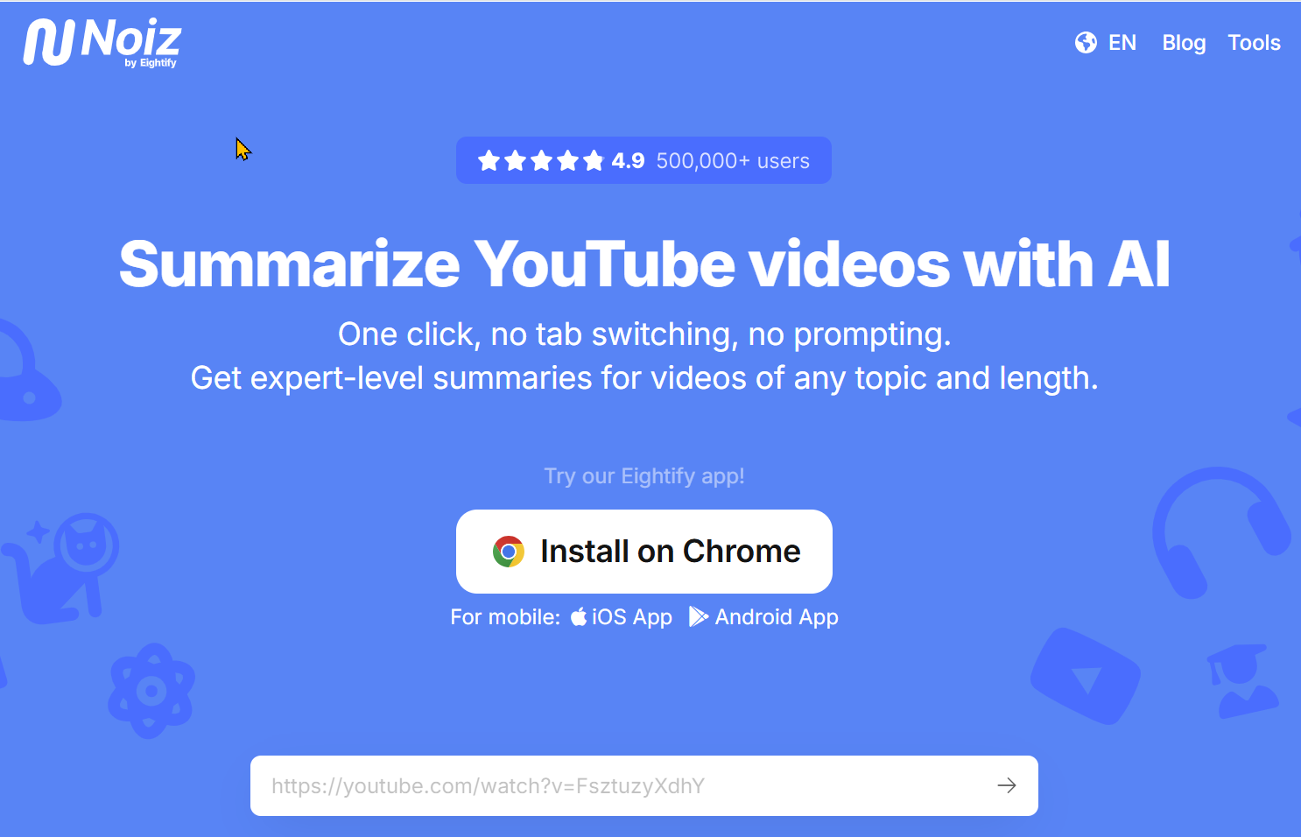
Noiz https://noiz.io/

Slide 30
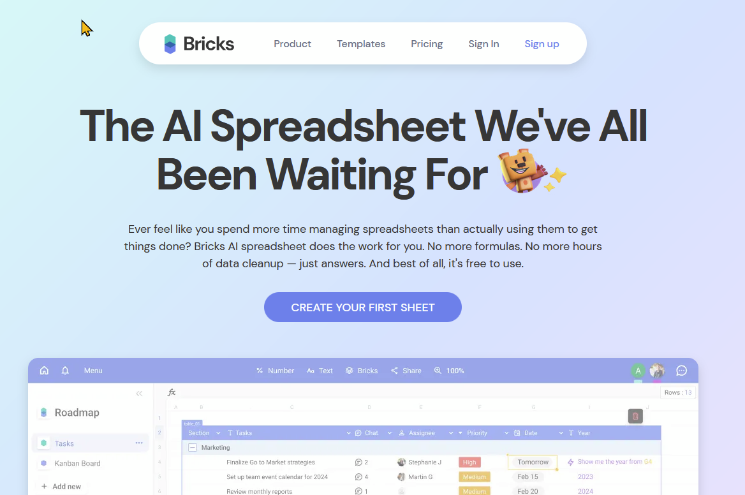
Bricks https://www.thebricks.com/

Slide 31
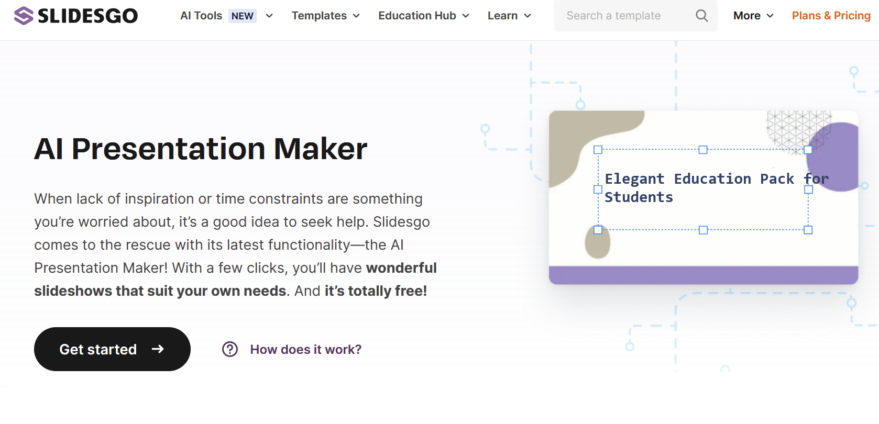
Slidesgo https://slidesgo.com/ai-presentations

Slide 32
Beyond AI

Slide 33
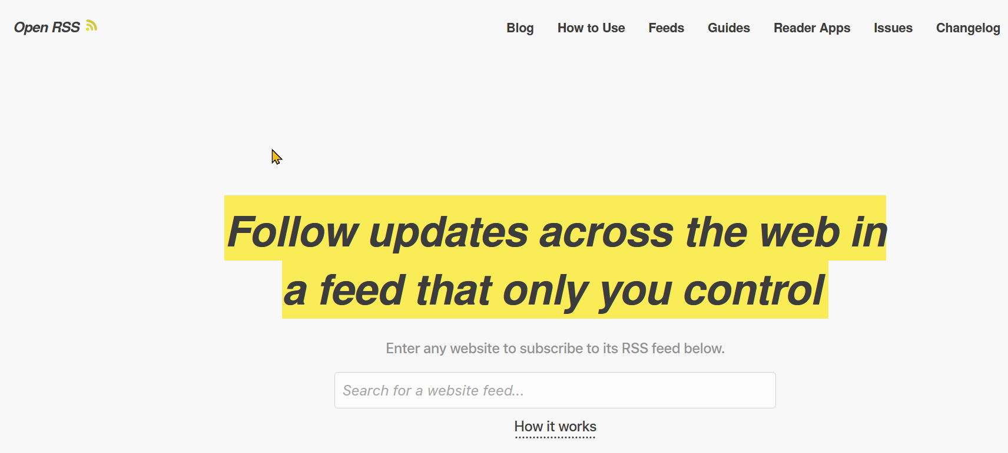
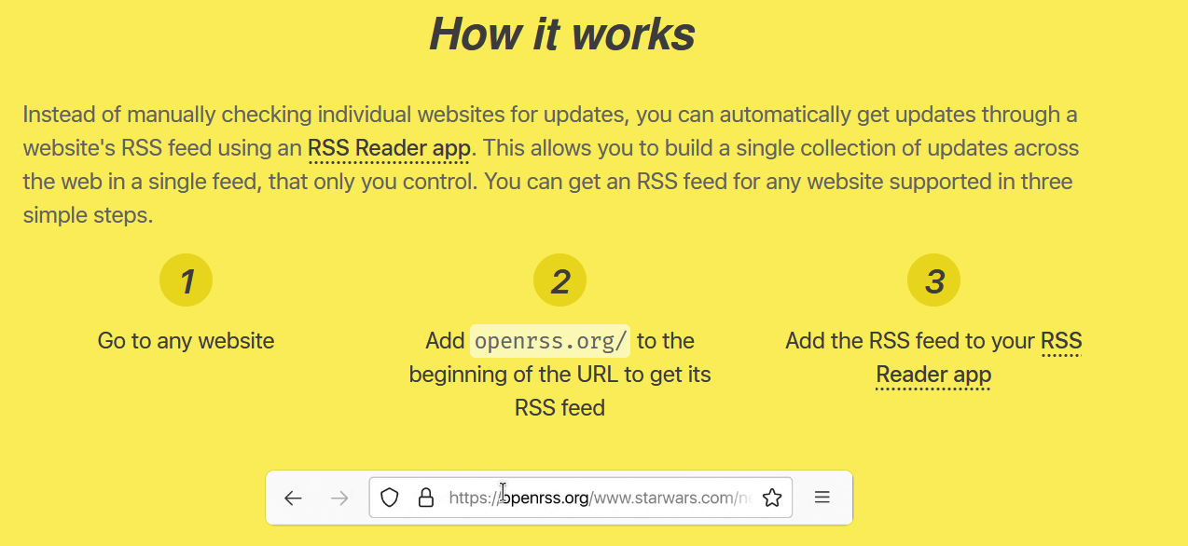
OpenRSS https://openrss.org/

Slide 34
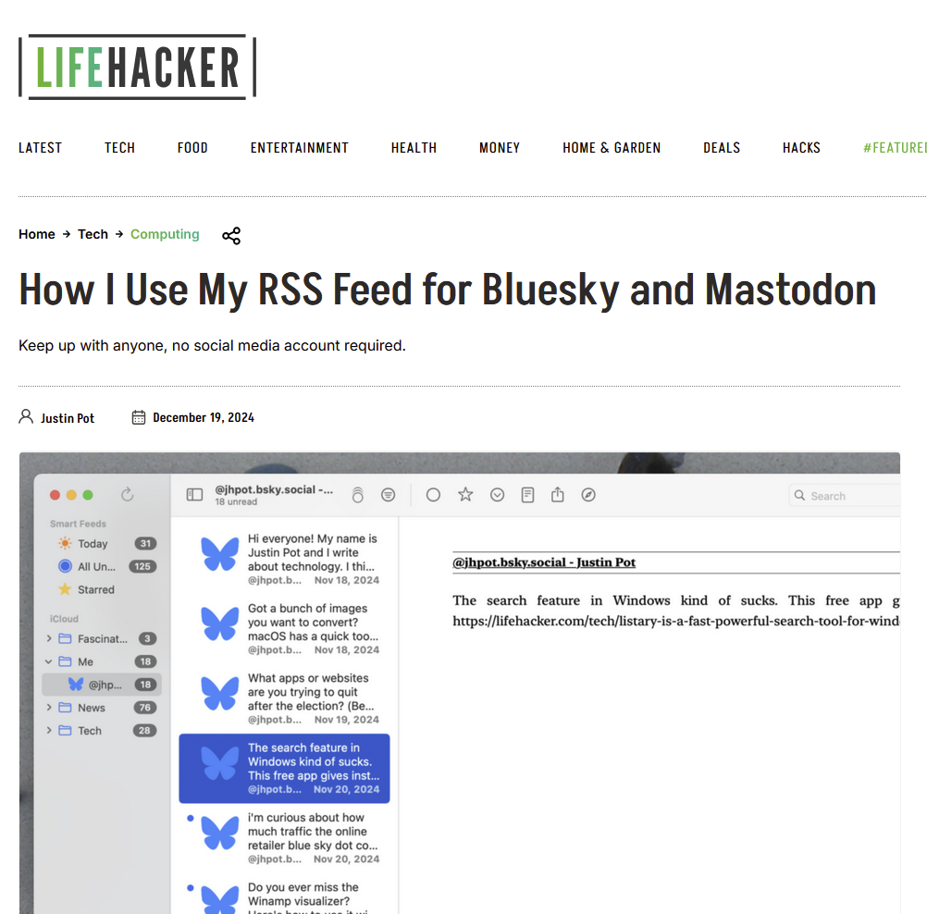
Keep up with Bluesky and Mastodon without an account https://lifehacker.com/tech/bluesky-and-mastodon-rss-feed

Slide 35
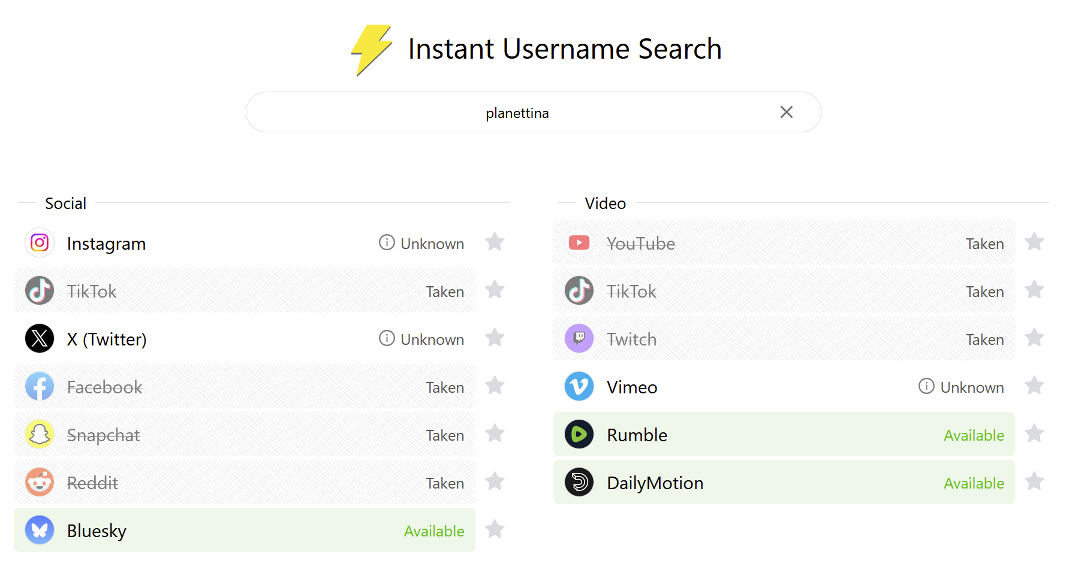
Instant Username Search https://instantusername.com/

Slide 36
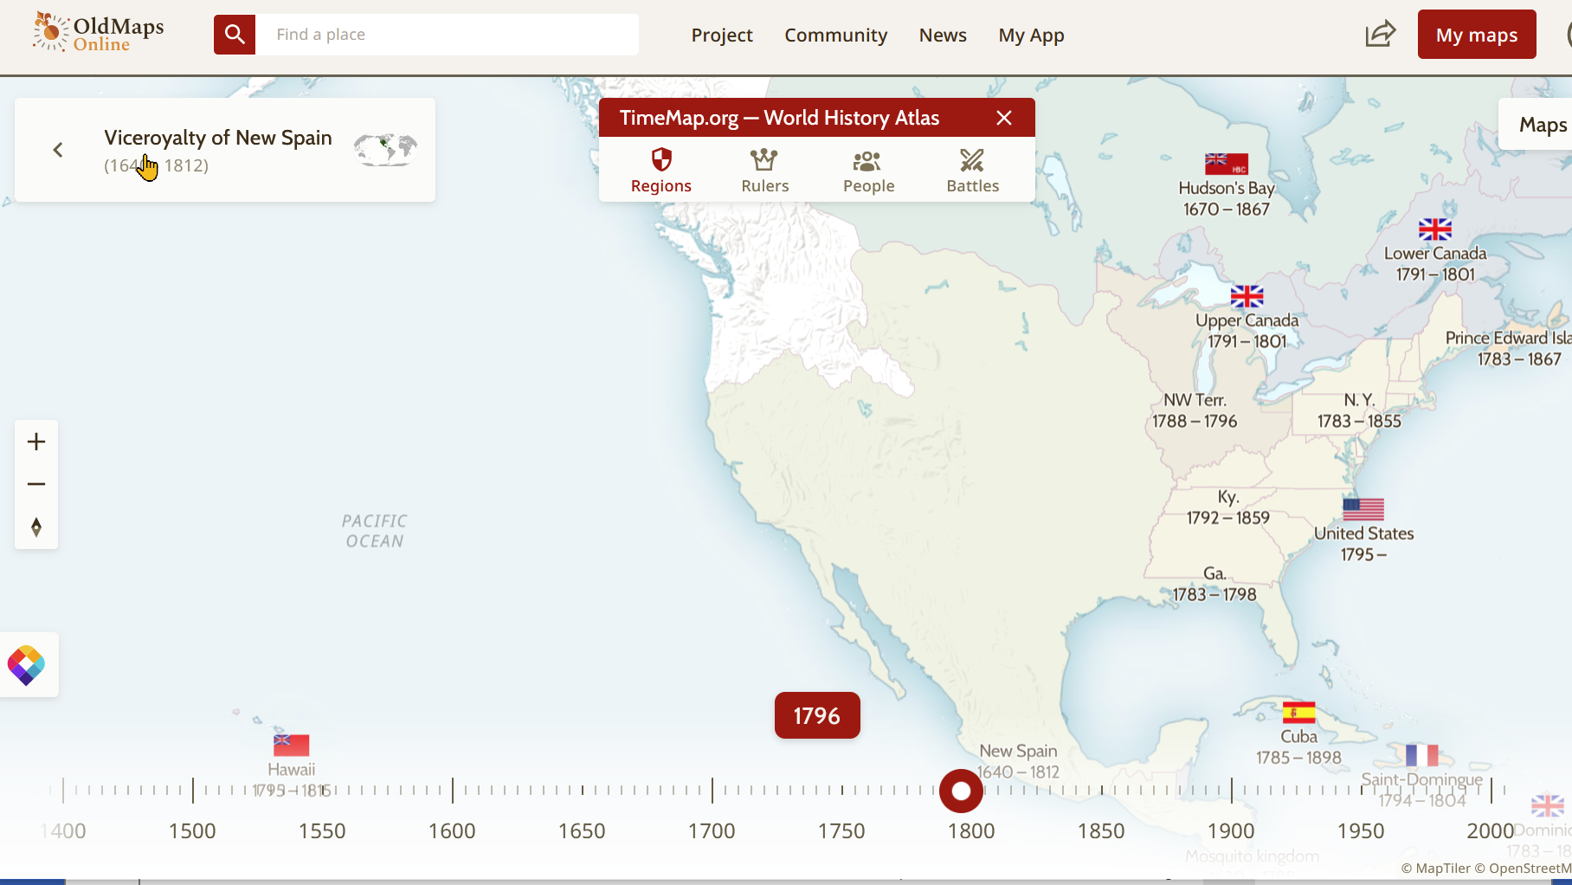
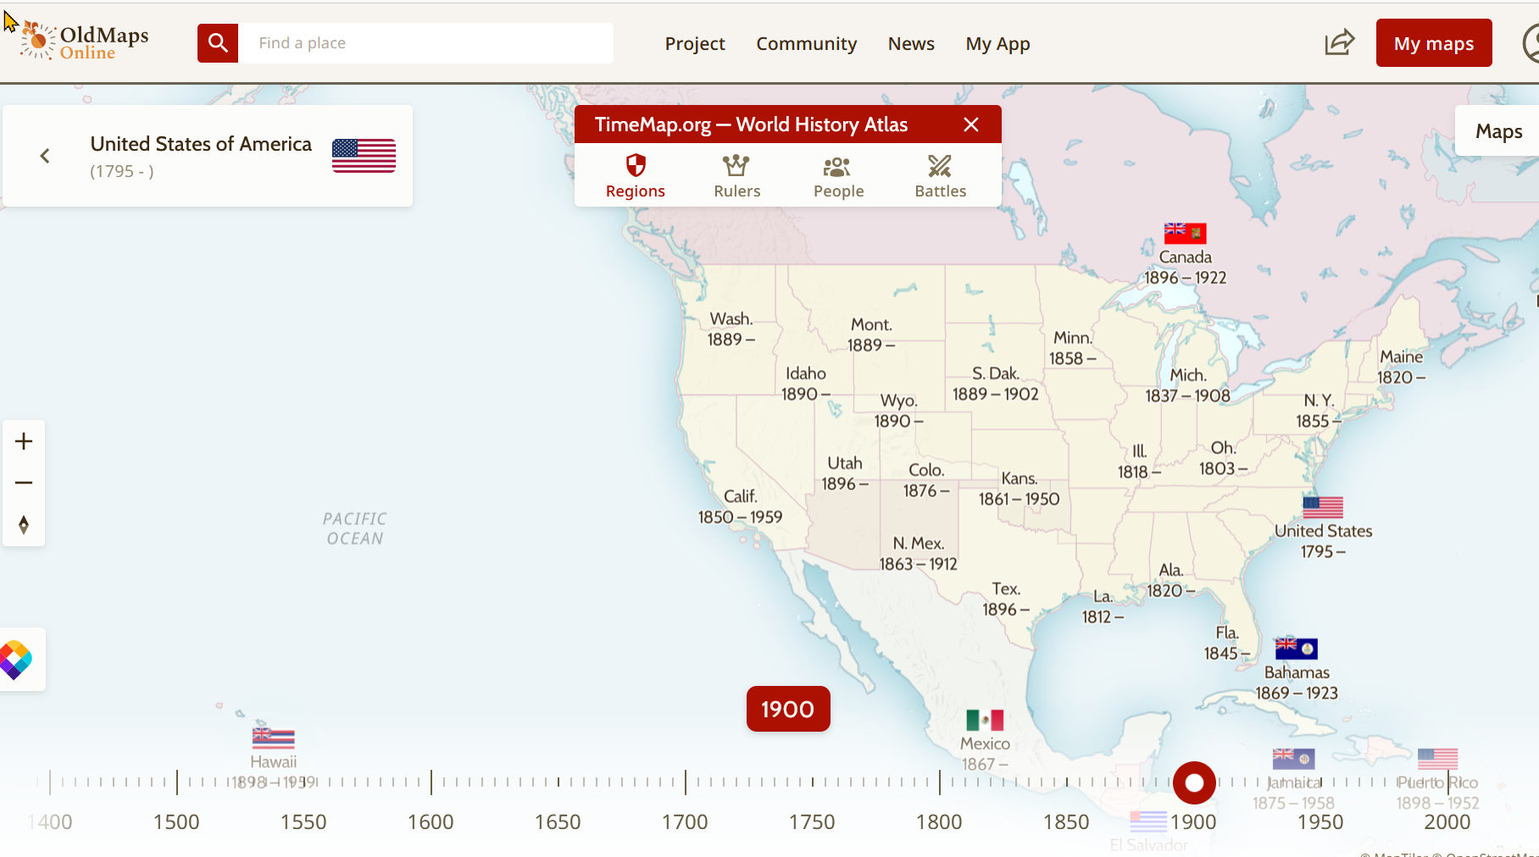
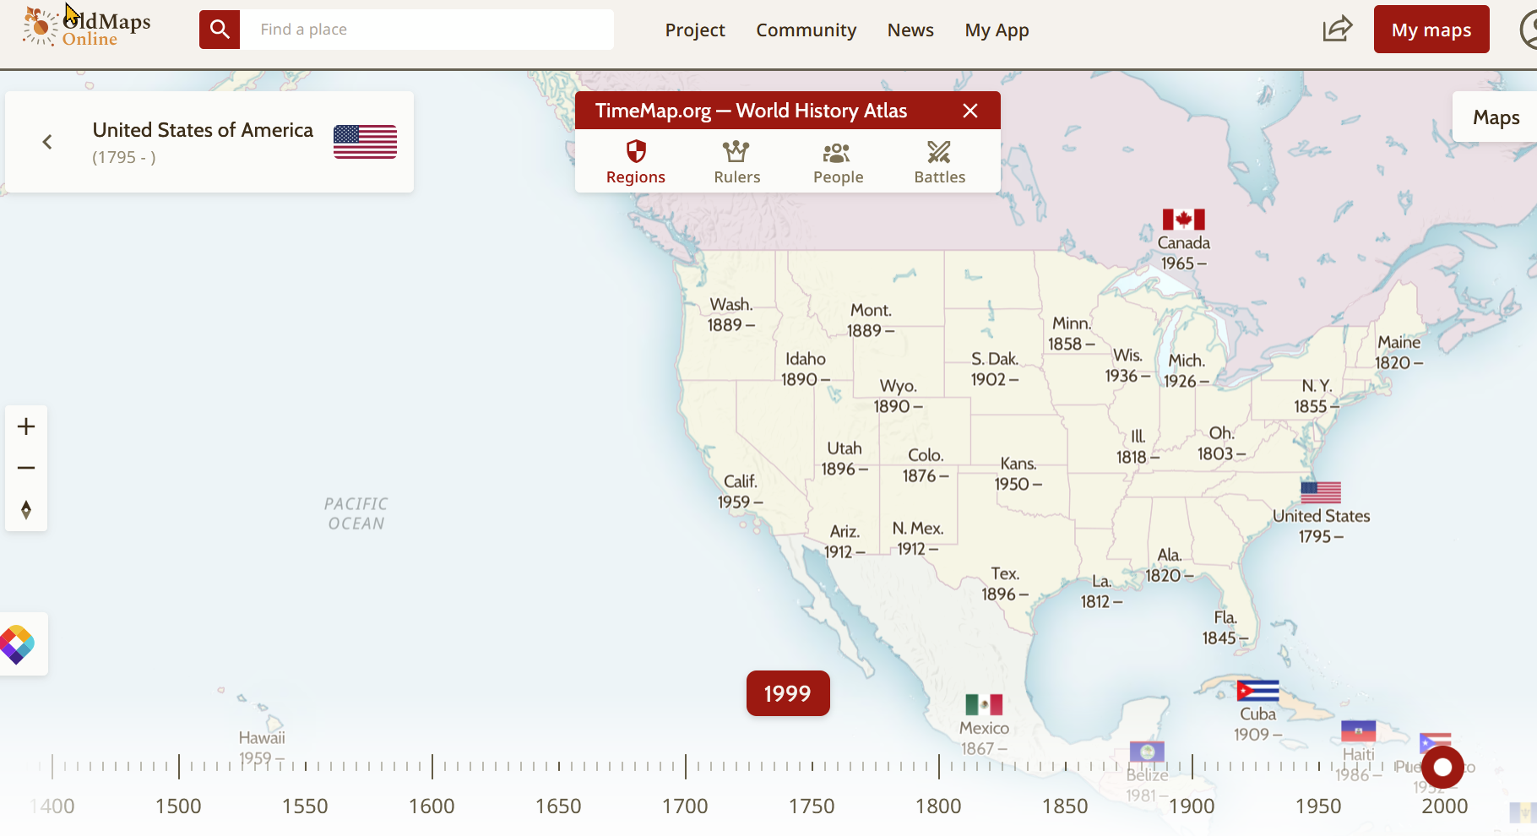

Slide 37
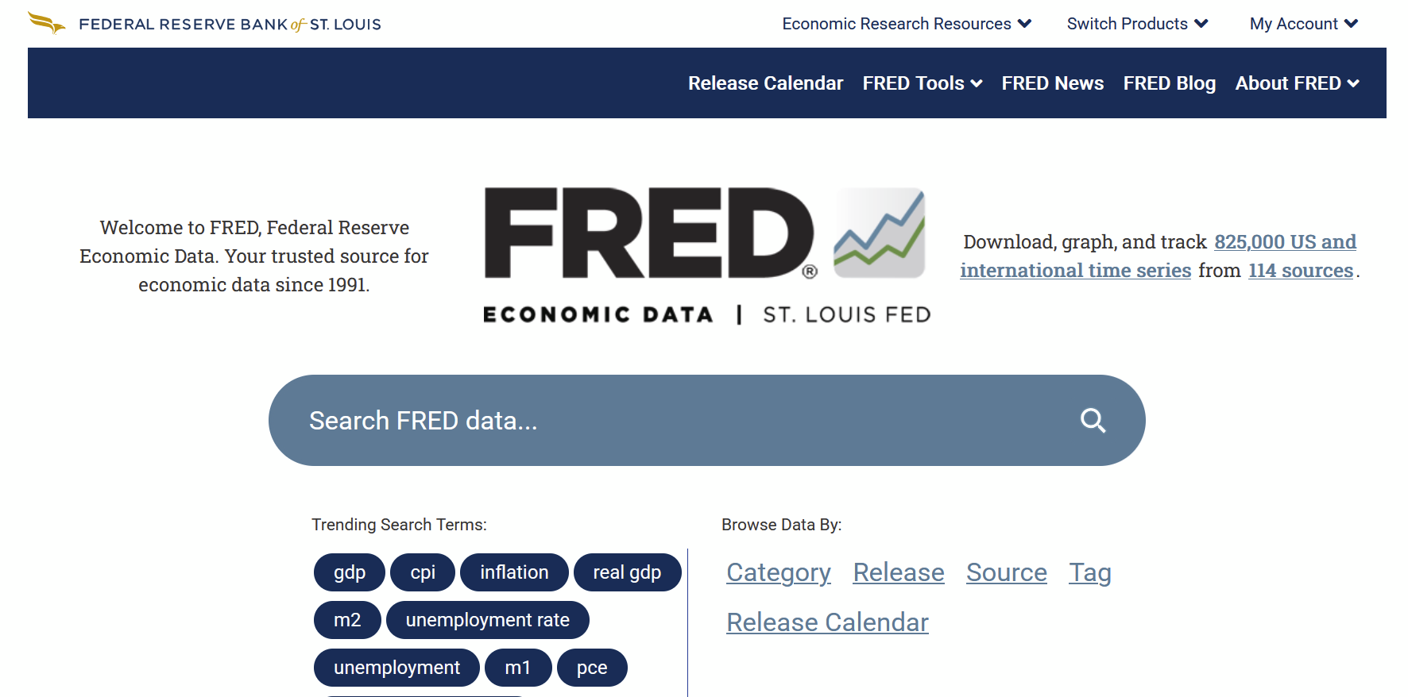
Federal Reserve Economic Data | FRED | St. Louis Fed https://fred.stlouisfed.org/

Slide 38
Thank you
Loyd Auerbach
loyd.auerbach@lexisnexis.com
Tina Dumas
tdumas@nossaman.com
www.tinyurl.com/SCALL30sites or www.bit.ly/SCALL30sites
Passcode once on Hightail: SCALL

Slide 39
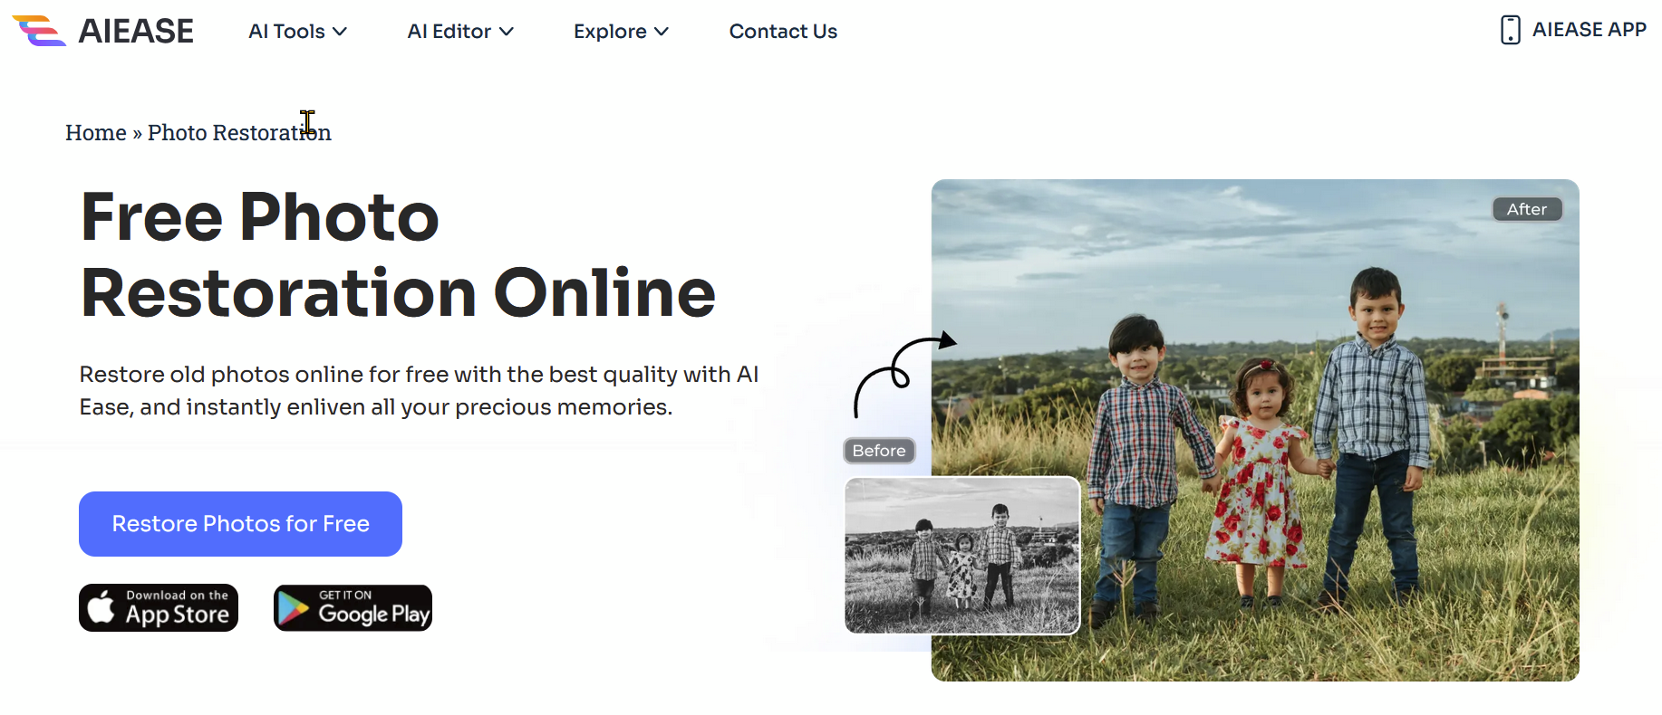
https://www.aiease.ai/photo-restoration/
FREE PHOTO RESTORATION ONLINE

Slide 40
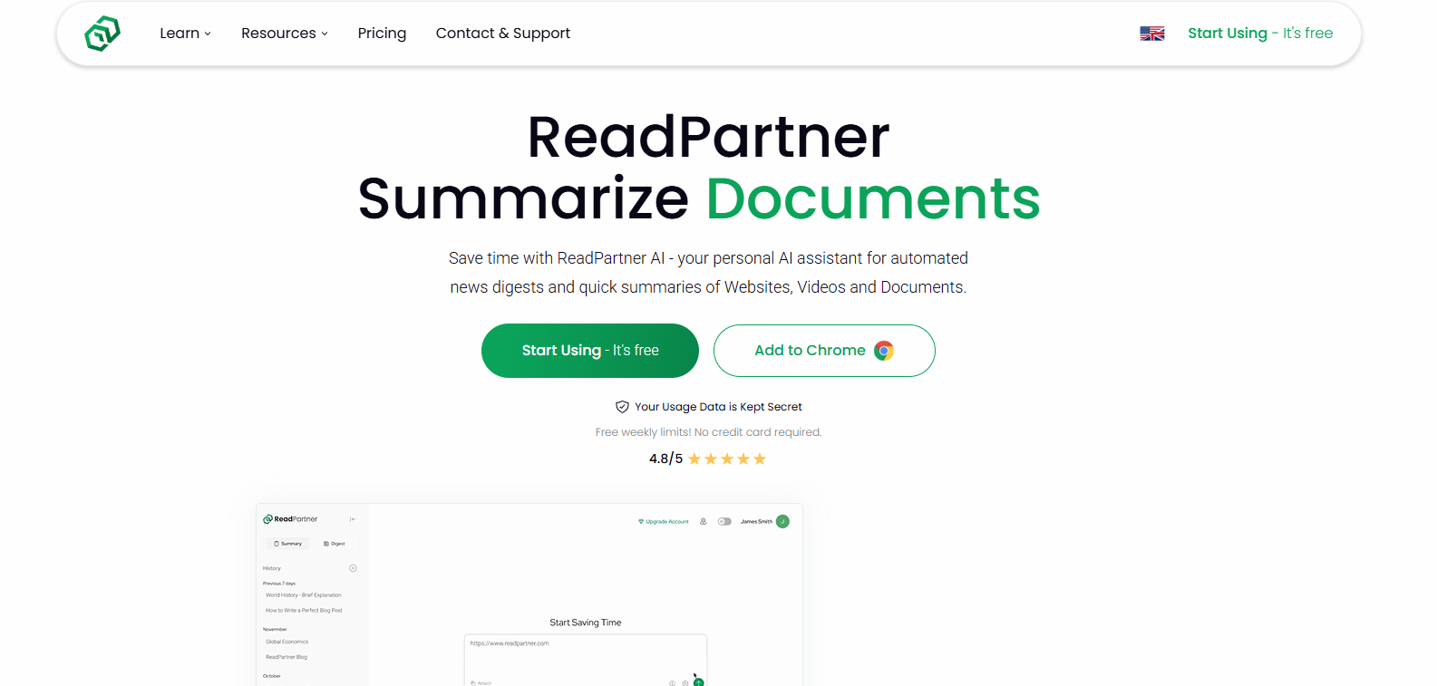
ReadPartner: AI News Automation & Summarization of Websites, Documents, Videos, Text and Articles https://readpartner.com/

Slide 41
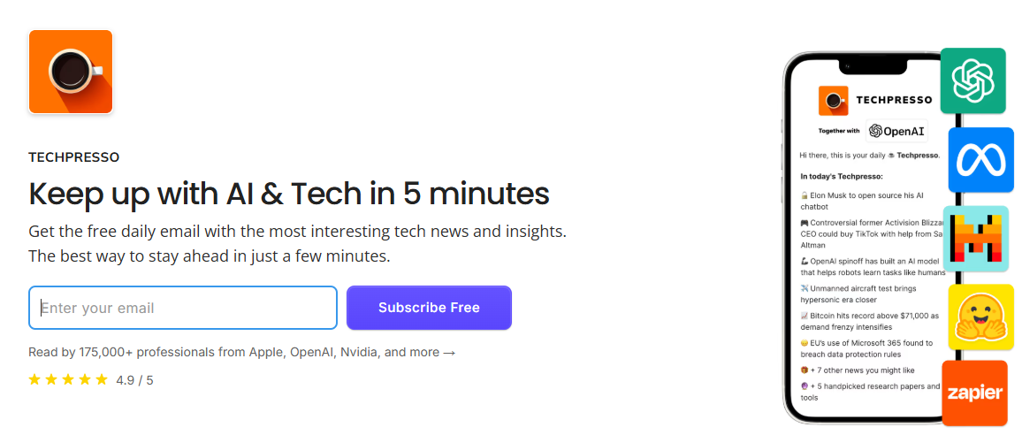
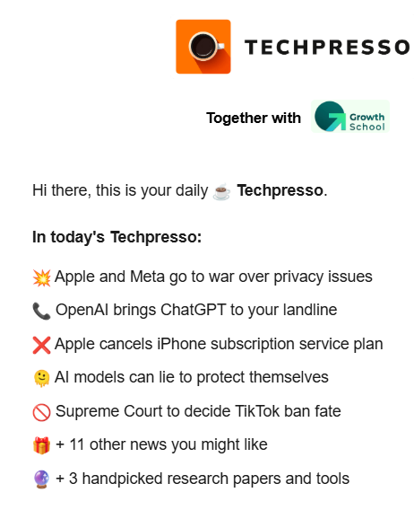
https://www.dupple.com/techpresso
E-newsletter - AI News with focus on tech

Slide 42
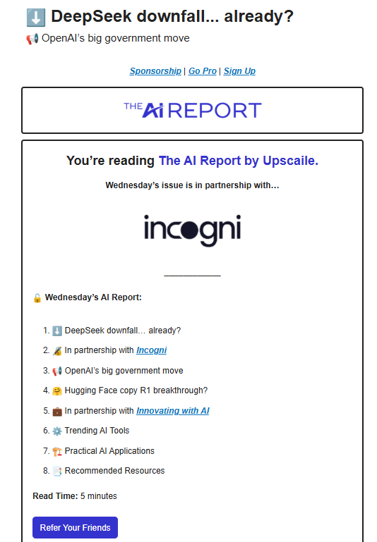
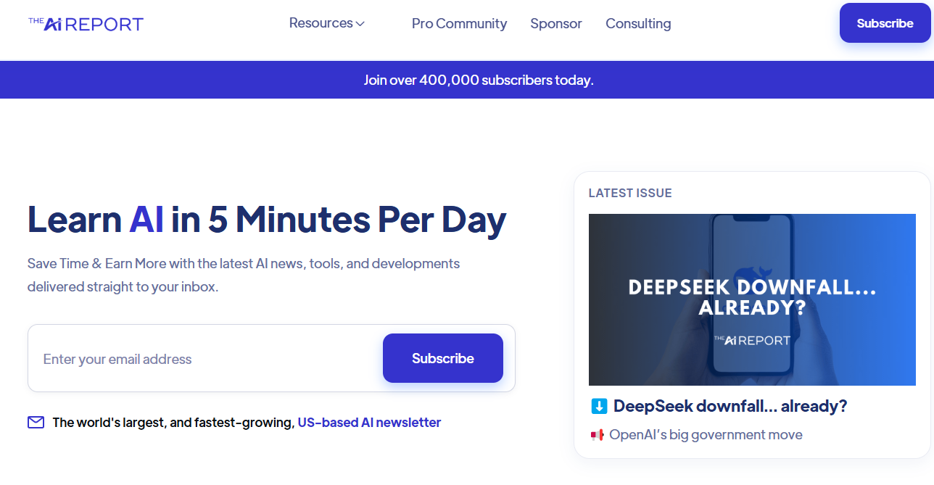
https://www.theaireport.ai/
E-newsletter

Slide 43
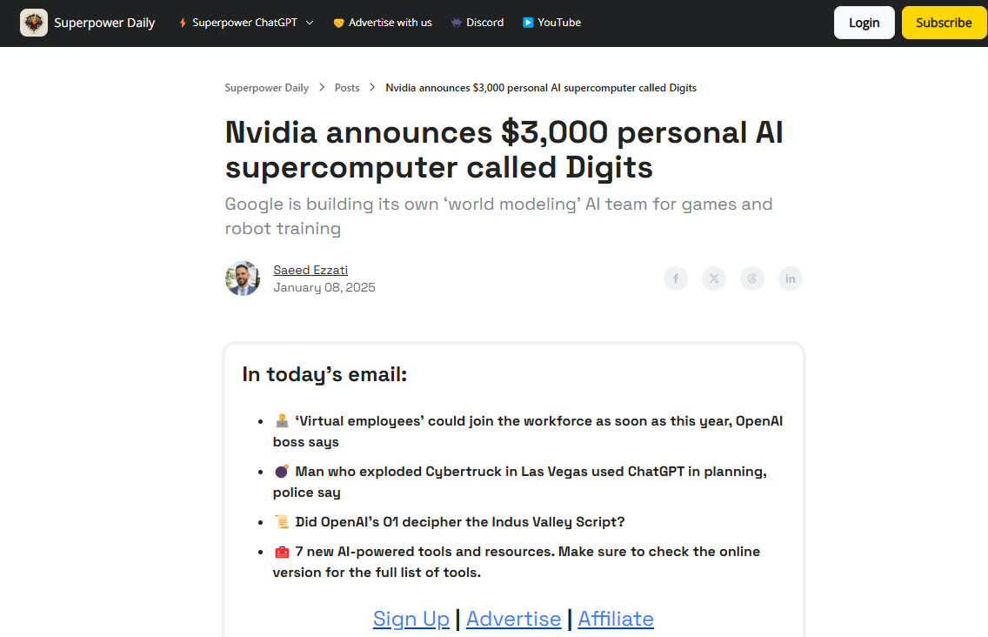
https://www.superpowerdaily.com/
E-newsletter: Superpower ChatGPT

Slide 44
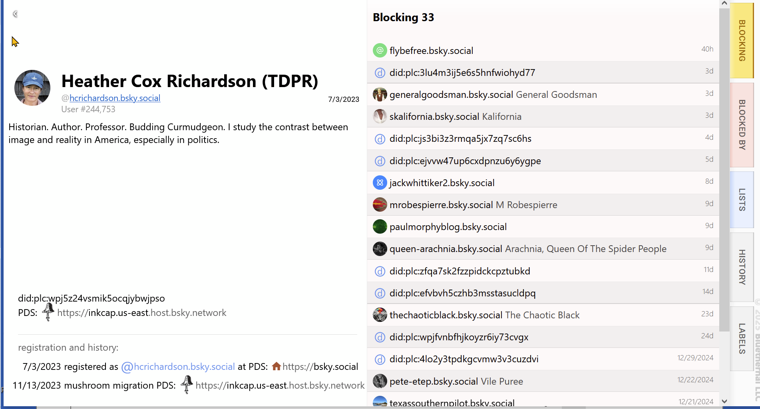
Clearsky.app

